Slide 1

Introductory Statistics and Hypothesis Testing
community project
encouraging academics to share statistics support resources
All stcp resources are released under a Creative Commons licence
Stcp-marshallowen-5a
Ellen Marshall / Alun Owen
University of Sheffield / University of Worcester
Reviewer: Ruth Fairclough
University of Wolverhampton
Notes:
These slides are aimed for use in the context of a workshop for training statistics tutors and not students wanting to learn statistics per say.
The aim of these slides is to provide a selection of materials you can use to discuss various topics in a workshop setting with new statistics tutors. You can select whichever slides you think cover the topics you would like to discuss with them.
The slides are divided into sections and some slides contain exercises with solutions you can use for either small group or whole group discussion.
These slides cover topics on hypothesis testing, comparing means, investigating relationships, choosing the right test and non-parametric tests. In addition there are “additional slides on more advanced topics such as ANOVA and logistic regression if you felt these were appropriate.

Slide 2
1. What is a Z-Score?
Simply put, a z-score (also called a standard score) gives you an idea of how far from the mean a data point is. But more technically it’s a measure of how many standard deviations below or above the population mean a raw score is.
A z-score can be placed on a normal distribution curve. Z-scores range from -3 standard deviations (which would fall to the far left of the normal distribution curve) up to +3 standard deviations (which would fall to the far right of the normal distribution curve). In order to use a z-score, you need to know the mean μ and also the population standard deviation σ.
Z-scores are a way to compare results to a “normal” population. Results from tests or surveys have thousands of possible results and units; those results can often seem meaningless. For example, knowing that someone’s weight is 150 pounds might be good information, but if you want to compare it to the “average” person’s weight, looking at a vast table of data can be overwhelming (especially if some weights are recorded in kilograms). A z-score can tell you where that person’s weight is compared to the average population’s mean weight.

Slide 3
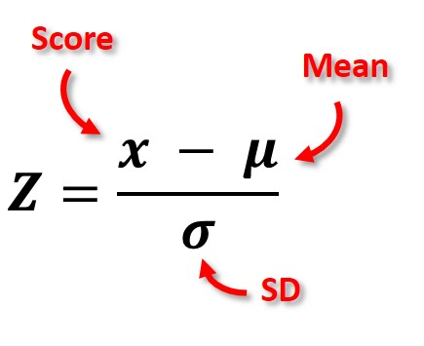
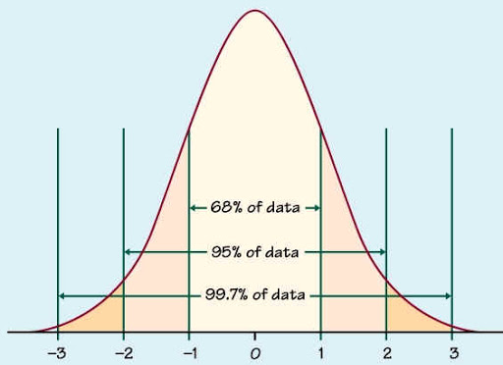
Z score=

Slide 4
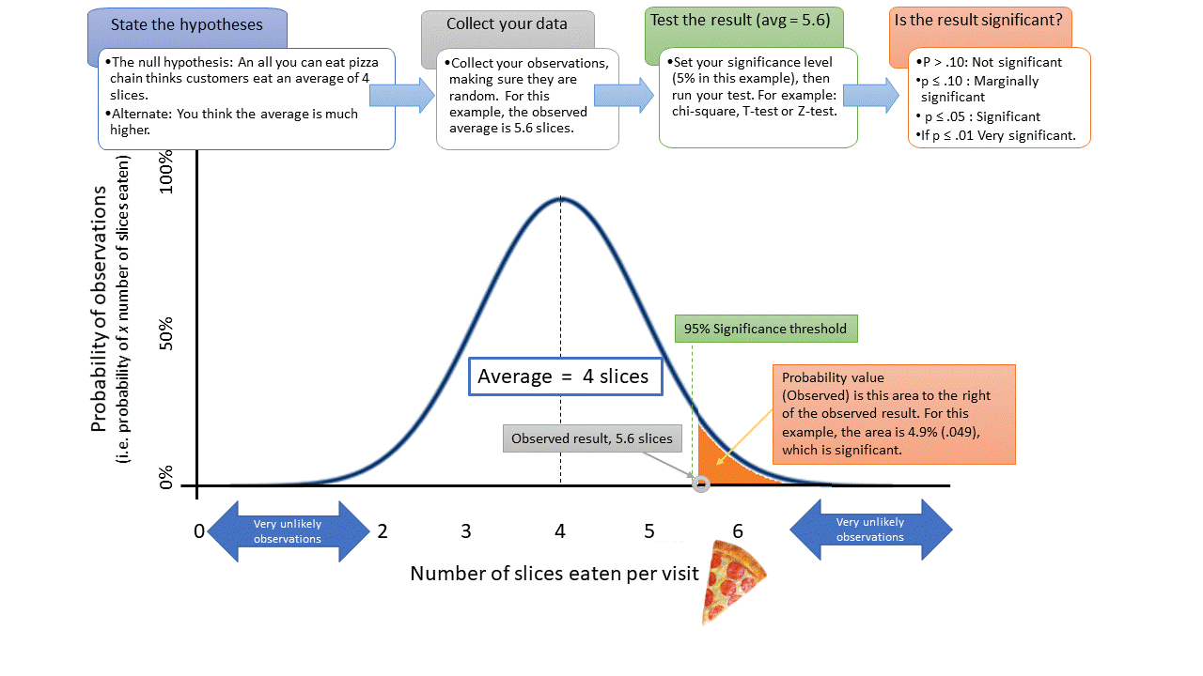

Slide 5
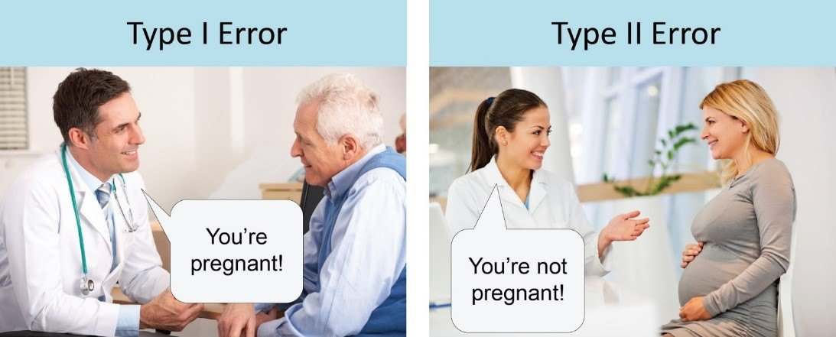

Slide 6
A t-test is a type of inferential statistic used to determine if there is a significant difference between the means of two groups

Slide 7
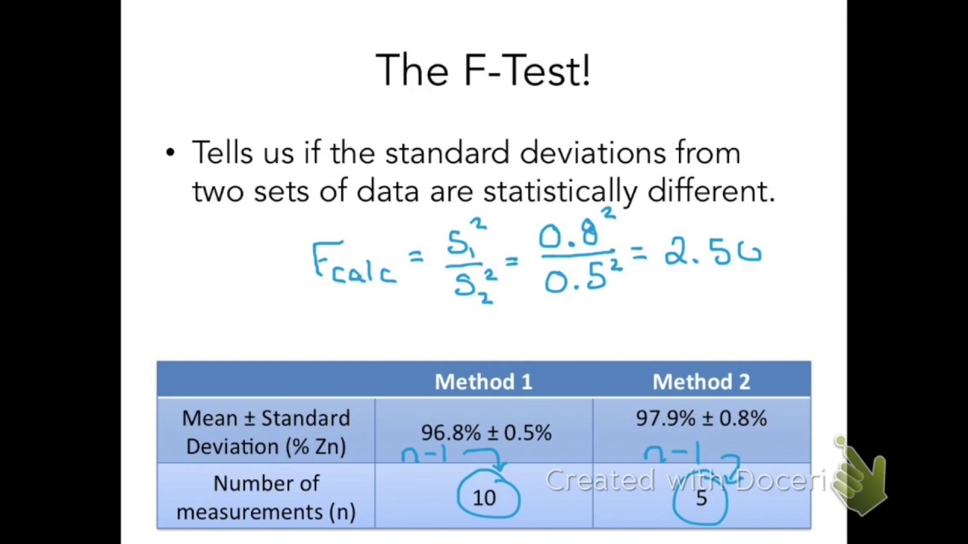

Slide 8
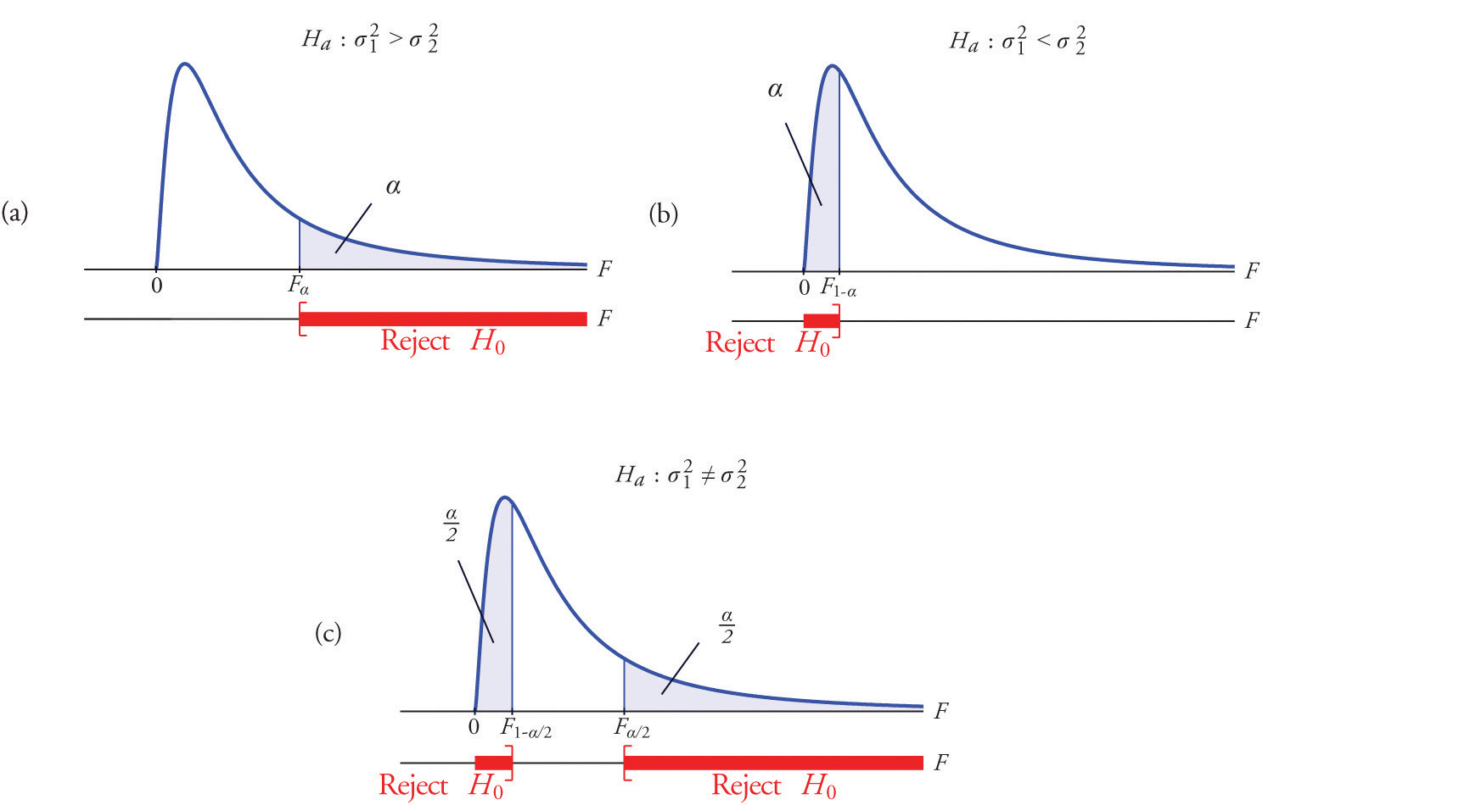

Slide 9
Related resources
Resources available on http://www.statstutor.ac.uk/
Paper scenario :Emmissions_scenario_Stcp-marshallowen-5b
Video scenario: :Mass_Customisation_Video_Stcp-marshallowen-1a
Top tips for stats support videos:
Careful_with_the_maths_Video_ Stcp-marshallowen-3a
Conjoint_Analysis_Video_Stcp-marshallowen-4a
Reference booklet: Tutors_quick_guide_to_statistics_7
SPSS training: Workbook: tutor_training_SPSS_workbook_6a, Solutions_for_tutor_training_SPSS_workbook_6b, Data_for_tutor_training_SPSS_workbook_6c
www.statstutor.ac.uk
Notes:
These are the resources which can be used alongside these slides for a training day. The top tips videos, paper and video scenarios are for use in the afternoon of the training day. The ‘Tutors guide’ and ‘SPSS workbook’ can be given out at the training day but are individual use by the new tutors.

Slide 10
Intended Learning Outcomes
At the end of today you should:
Have improved your ability to recall and describe some basic applied statistical methods
Have developed ideas for explaining some of these methods to students in a maths support setting
Feel more confident about providing statistics support with the topics covered
Notes:
This workshop is aimed at mathematicians who also need to give statistics support. One day will not turn you into a statistician but it is hoped that by the end of the day you will feel more comfortable offering support to students coming in with statistics questions.

Slide 11
Content
Summary Statistics
Concepts of hypothesis testing
T-tests
Confidence intervals
Correlation and Regression
Choosing the right test
What is a non-parametric test?
Statistics scenarios
Top tips
ANOVA (if time)
Notes:
These are the topics we will cover today. The morning session will introduce basic hypothesis testing and later this afternoon you will put some of this knowledge into practice.

Slide 12
What we won’t cover
Lots of maths!!!
Students coming to statistics support usually want help with using SPSS, choosing the right analysis and interpreting output
They often find maths scary and so you need to think of ways of explaining without the maths
Notes:
We won’t be covering the maths involved in statistics for a couple of reasons. We don’t have time to cover all the topics in detail and for most students, you won’t need to use it. Sometimes students from departments such as Economics will want to use the formula involved in statistics but they will have notes and as mathematicians, you should be able to use the formula given without much trouble. The majority of students want help with choosing the right test, carrying out the analysis and interpreting the output which is what we will concentrate on today.

Slide 13
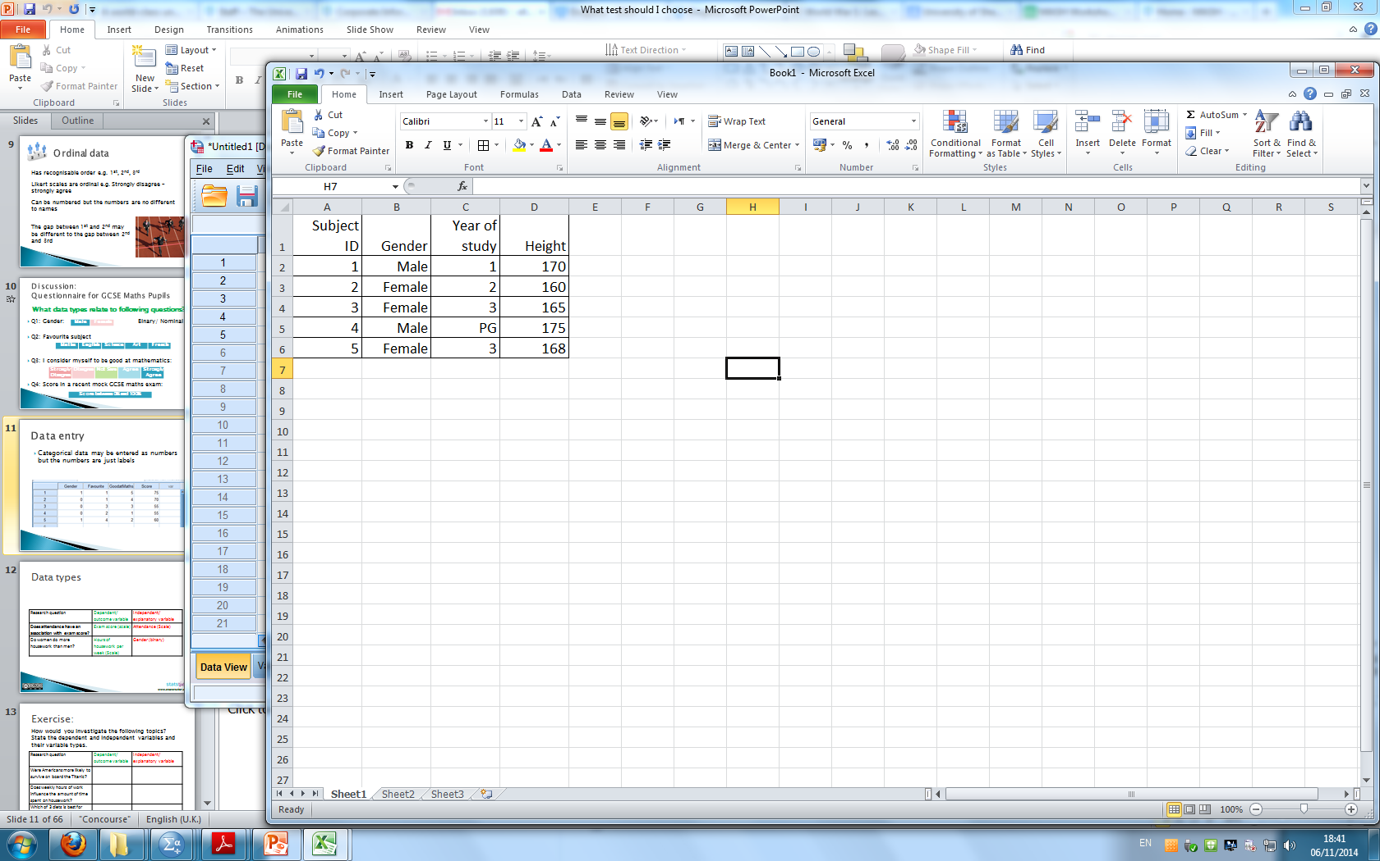
Data and variables
DATA: the answers to questions or measurements from the experiment
VARIABLE = measurement which varies between subjects e.g. height or gender
One variable per column
One row per subject
Notes:
For all types of quantitative data, it’s likely that it will end up in a spread sheet with individuals/ subjects on rows and each column representing a variable e.g. answer to Q1 from a questionnaire or heart beat after running for 5 mins. A variable is just a measurement which varies between subjects. The variable is usually the answer to questions or results of the experiment.

Slide 14
Data types
Data Variables
Scale
Measurements/ Numerical/ count data
Categorical:
appear as categories
Tick boxes on questionnaires
Notes:
What types of data are there? Within the data structure there are observations or individuals, and for each observation there are data variables. These variables can be classified into two main groups, Scale and categorical.
Categorical variables indicate categories and questions with categorical answers usually appear as tick boxes on questionaires. Scale variables are either measurements or counts.

Slide 15


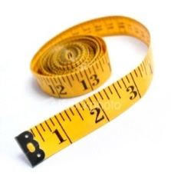

Data types
Variables
Scale
Categorical
Continuous
Measurements
takes any value
Discrete:
Counts/ integers
Ordinal:
obvious order
Nominal:
no meaningful order
Notes:
Categorical variables can be divided into two: ordinal and nominal. If the categories are meaningfully ordered, the variable is ordinal; if it doesn’t matter in which way the categories are ordered, then the variable is nominal. For example, satisfaction levels (dissatisfied, satisfied and highly satisfied) and education level (secondary, sixth form, undergraduate and postgraduate) are ordinal variables; Student’s religion (Christian, Muslim, Hindu, etc) and favourite animal are nominal variables.
Scale variables appear as meaningful comparable numbers, such as blood pressure, height, weight, income, age, and probability of illness etc. Numerical variables can be further divided into two subtypes: continuous and discrete. The continuous variables can take any value within a range and are the most common, e.g. body weight, height, income, etc. Discrete variables can only take whole numbers, such as number of students in class, number of new patients every day, etc but are treated as continuous for statistical analysis if there are a large range of numbers.
One point to make is that if ordinal data is scored as ranks such as 1, 2, 3 etc., and then this data is analysed as scale data, then a rather strong assumption is being made that the distances between the value of any pair of neighbouring ranks (e.g. 1 and 2 or 2 and 3 etc.) is the same, which is unlikely in practice to be true. Students often find the difference between ordinal and discrete difficult especially when ordinal is categorised as numbers
The point is that whilst this might not be the most interesting place to start – students need to be aware of the data they have since this affects what analyses are/not suitable.

Slide 16
Questionnaire for GCSE Maths Pupils
What data types relate to following questions?
Q1: What is your favourite subject?
Q2: Gender:
Q3: I consider myself to be good at mathematics:
Q4: Score in a recent mock GCSE maths exam:
Maths | English | Science | Art | French
Male | Female
Strongly Disagree | Disagree | Not Sure | Agree | Strongly Agree
Score between 0% and 100%
Notes:
Ask the audience what data types these are giving them time to think before going through the answers as a group.

Slide 17
Questionnaire for GCSE Maths Pupils
What data types relate to following questions?
Q1: What is your favourite subject?
Q2: Gender:
Q3: I consider myself to be good at mathematics:
Q4: Score in a recent mock GCSE maths exam:
Nominal
Maths | English | Science | Art | French
Male | Female
Binary/ Nominal
Strongly Disagree | Disagree | Not Sure | Agree | Strongly Agree
Ordinal
Score between 0% and 100%
Scale
Notes:
The answers. Point out that binary variables are a special case of nominal variables.
Ordinal variables are the one students get most confused about. Make it clear that although we usually number categorical variables in SPSS, this does not make them scale. The numbers are just labels. People come 1st, 2nd, 3rd etc in a race but the distance between 1st and 2nd may not be the same as the distance between 2nd and 3rd.

Slide 18
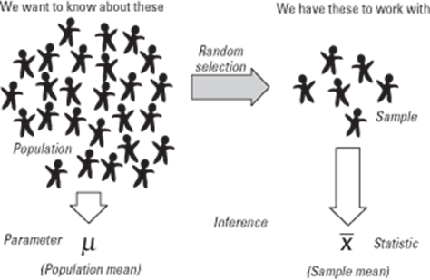
Populations and samples
Taking a sample from a population
Sample data ‘represents’ the whole population
Notes:
Inferential statistics centres around using a sample of subjects to represent a population. A population is the group of interest. A random selection from this population is called a sample. Statistics such as the mean and standard deviation are calculated using the sample data and used to estimate the population parameters.

Slide 19
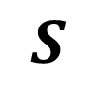
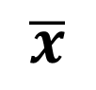
Point estimation
Sample data is used to estimate parameters of a population
Statistics are calculated using sample data.
Parameters are the characteristics of population data
sample mean
Sample SD
Population mean
Population SD
$$\overline{x}$$
estimates
$$S$$
Notes:
We use x bar and s to represent the sample mean and standard deviation but we are really interested in the parameters of the population. The population parameters are represented by mu and sigma.

Slide 20
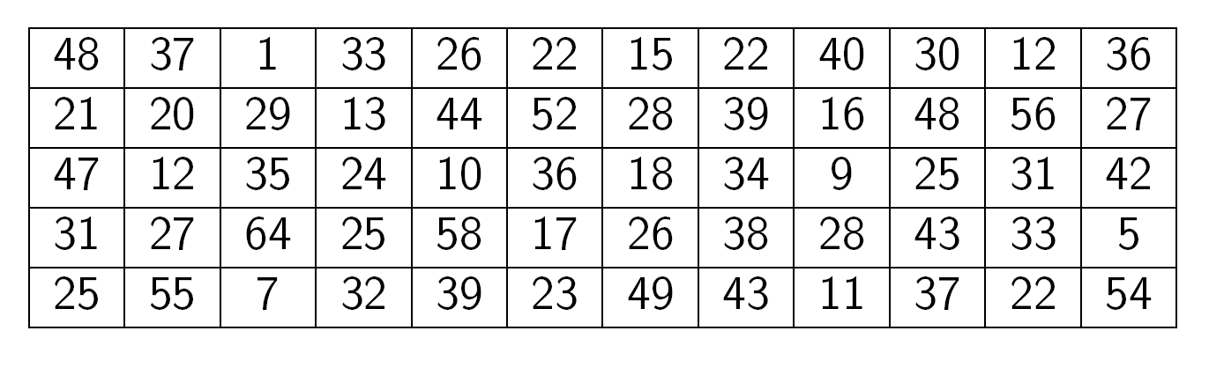
How can exam score data be summarised?
Exam marks for 60 students (marked out of 65)
mean = 30.3 sd = 14.46
Notes:
Student data on exam scores has been collected for a class of 60 students. How can this be summarised? Start by producing a histogram.

Slide 21
Summary statistics
Mean =
Standard deviation (s) is a measure of how much the individuals differ from the mean
Large SD = very spread out data
Small SD = there is little variation from the mean
For exam scores, mean = 30.5, SD = 14.46

Slide 22
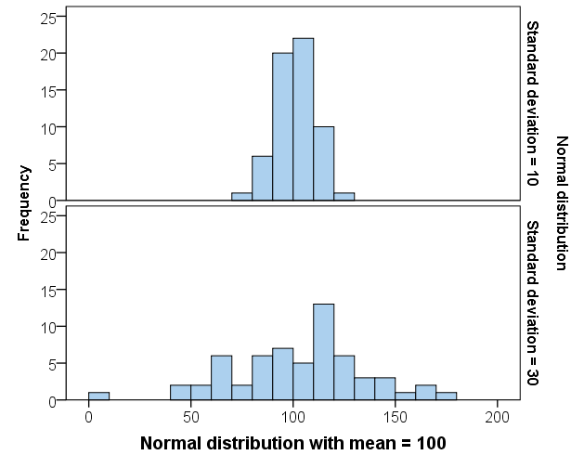
Interpretation of standard deviation
The larger the standard deviation, the more spread out the data is.
Notes:
For most students, the standard deviation is calculated using the computer so it is the interpretation that is most important. Showing them how standard deviation is a measure of spread using histograms is helpful.

Slide 23
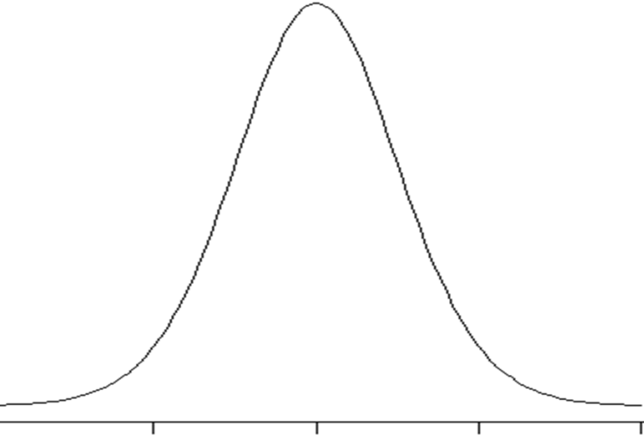
Scale data
To analyse it we often
If have scale data
Normal distribution
assume it follows a
ormal
Notes:
Most attending the workshop will be familiar with the normal distribution, but its important to highlight that this assumption is behind much of what students do when analysing scale data. But they might not have considered how to explain to a student in a maths support session what we mean by data being assumed to follow a normal distribution.
This slide and those that follow illustrate the steps taken to create a histogram and how this can be thought of as an empirical probability distribution and so how it can be used to assess whether it seems reasonable to assume that this empirical probability distribution comes from a normal distribution.

Slide 24
Discussion
How could you explain to a student what we mean by data being assumed to follow a Normal Distribution?
Notes:
Ask for the audience to offer their ideas before presenting the ideas contained on the following slides.

Slide 25
Group Frequency Table
 |  | Frequency | Percent
 | 0 but less than 10 | 4 | 6.7
 | 10 but less than 20 | 9 | 15.0
 | 20 but less than 30 | 17 | 28.3
 | 30 but less than 40 | 15 | 25.0
 | 40 but less than 50 | 9 | 15.0
 | 50 but less than 60 | 5 | 8.3
 | 60 or over | 1 | 1.7
 | Total | 60 | 100.0
Notes:
You could explain what the normal distribution is by building a histogram from data. Here the exam score data is used.
First build a frequency distribution by counting the number of students within each category.

Slide 26
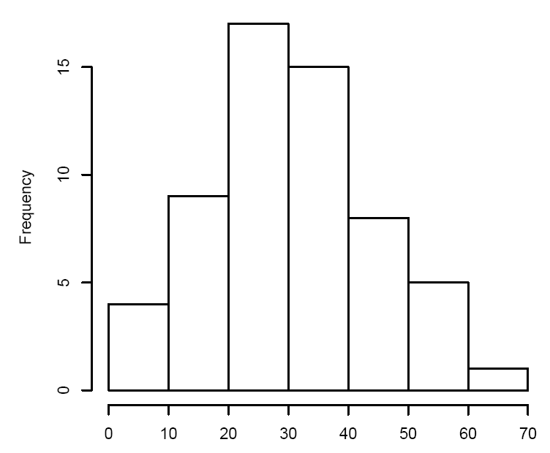
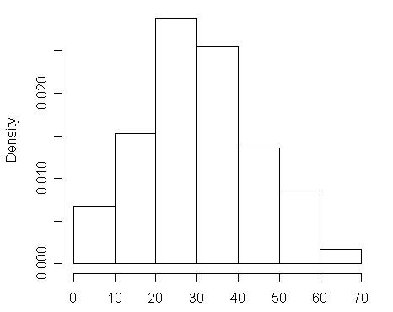
Histogram and Probability Distribution for Exam Marks Data
Notes:
Next use the frequencies to construct the histogram. This is called a frequency distribution. To get a probability distribution, divide each bar by the total number of students (60).

Slide 27
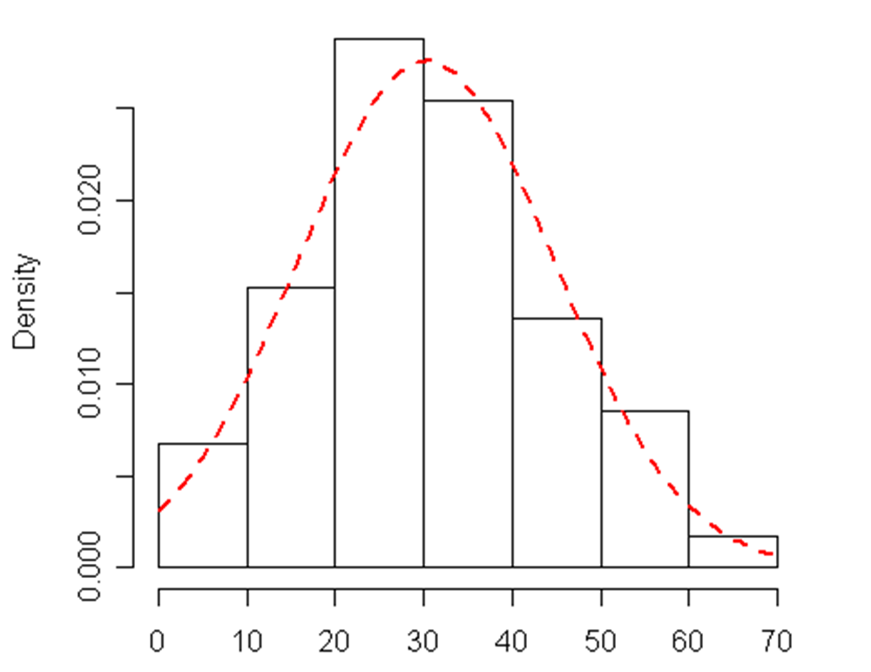
Histogram and Probability Distribution for Exam Marks Data
Notes:
A normal curve can be added which smoothes out the histogram. This can be used to estimate probabilities given the mean and standard deviation.

Slide 28
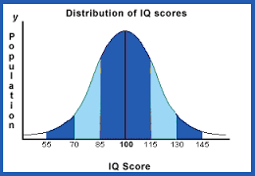
IQ is normally distributed
Above average
Average
Mensa
Mean = 100, SD = 15.3
Notes:
This is the probability distribution as a curve for IQ. The mean is 100 and the standard deviation shows the spread. For a perfect normal distribution, 50% of the population are above the mean and 50% are below. Most people are between 70 and 130 with a few above 145. The probability of randomly selecting a person from the population with an IQ above 145 is very small.

Slide 29
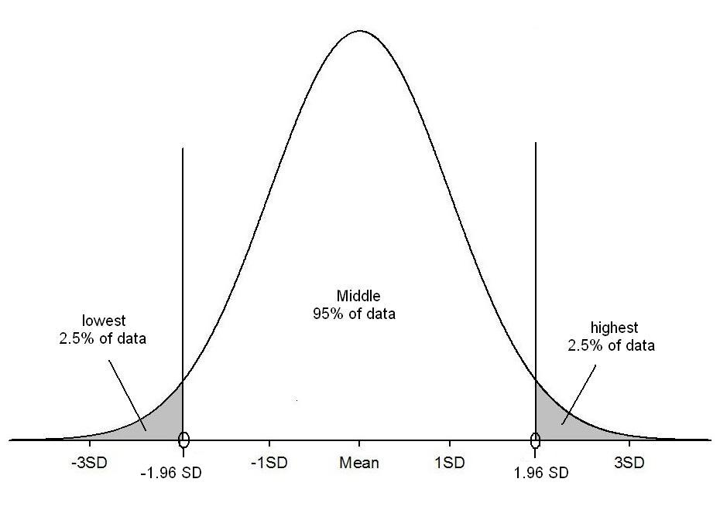
95% 1.96 x SD’s from the mean
95% of values
P(score > 130) = 0.025
100
130
70
95% of people have an IQ between 70 and 130
Notes:
Another important fact about normally distributed data is that 95% of the population lie between plus and minus 1.96*SD’s of the mean. For the IQ data this means that 95% of people have an IQ between 70 and 130 with only 2.5% above 130. This is important when understanding confidence intervals.

Slide 30
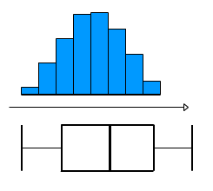
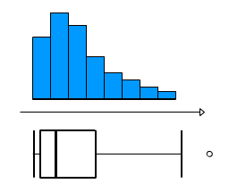
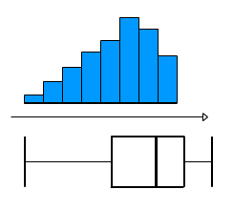
Assessing Normality
Charts can be used to informally assess whether data is:
Normally
distributed
Or….Skewed
The mean and median are very different for skewed data.
Notes:
normality is an important issue in statistics. This can be assessed graphically using a histogram or box-plot. The first pair show a perfect normal distribution. When assessing normality, we are only concerned with data that is very skewed as in the second and third pairs of graphs. Comparing means and medians can also help as the wider apart they are the more skewed the data is.

Slide 31
Discussion
Is the following statement:
“2 out of 3 people earn less than the average income”
True
False
Don’t know
Notes:
The aim of this question is to illustrate that there are several averages and that the median sometimes makes more sense.

Slide 32
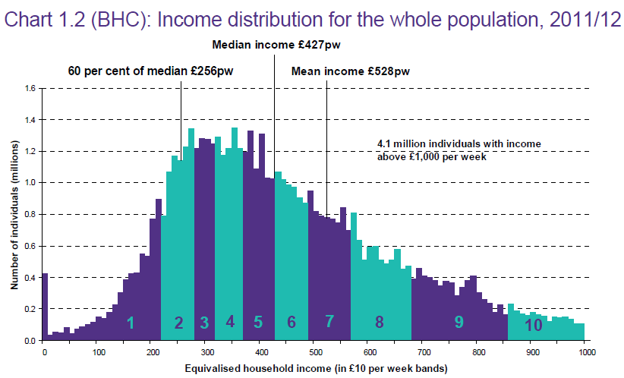
Sometimes the median makes more sense!
2/3rd people
50% people
Source: Households Below Average Income: An analysis of the income distribution1994/95 – 2011/12, Department for Work and Pensions
Notes:
Could also comment that for ordinal data the median also makes more sense irrespective of the distribution.

Slide 33
Choosing summary statistics
Which average and measure of spread?
Scale
Categorical
Normally distributed
Mean (Standard deviation)
Skewed data
Median (Interquartile range)
Ordinal:
Median
(Interquartile range)
Nominal:
Mode (None)
Notes:
The best average to use depends on the type of data. Only the mode can be used for nominal data although the mean of binary 0/ 1 data is the proportion coded as 1. For skewed and ordinal data, the median and interquartile range are preferable and for normally distributed data, the mean and standard deviation are used.

Slide 34
Which graph? Exercise
1st variable | Only 1 variable | Scale | Categorical
Scale | Histogram | Scatter plot | Box-plot/ Confidence interval plot
Categorical | Pie/ Bar | Box-plot/ Confidence interval plot | Stacked/ multiple bar chart
Which graph would you use when investigating:
Whether daily temperature and ice cream sales were related?
Comparison of mean reaction time for a group having alcohol and a group drinking water
Notes:
The right graph to use also depends on the type of variable. If there is just one scale variable, a histogram is best to show the spread of the data. For one categorical variable, a bar or pie chart can be used although a bar chart is better for ordinal data. For 2 categorical variables a stacked or multiple bar chart can be used and for two scale variables a scatterplot is preferable. When comparing scale measurements by group, a boxplot or confidence interval plot can be used. A box-plot shows the spread of individual scores whereas the confidence interval plot gives a range of values for the population mean of each group.
Student exercise: Think about which graph should be used in each of the two situations and interpret the summary statistics on the next slide.

Slide 35
Exercise: Ticket cost comparison
Summary statistics for cost of Titanic ticket by survival
Is there a big difference in average ticket price by group?
Which group has data which is more spread out?
Is the data skewed?
Is the mean or median a better summary measure?
Cost of ticket | Survived?
 | Died | Survived
Mean | 23.4 | 49.4
Median | 10.5 | 26
Standard Deviation | 34.2 | 68.7
Interquartile range | 18.2 | 46.6
Minimum | 0 | 0
Maximum | 263 | 512.33
www.statstutor.ac.uk
Notes:
Student exercise to work on in groups.

Slide 36
Which graph? Solution
1st variable | Only 1 variable | Scale | Categorical
Scale | Histogram | Scatter plot | Box-plot/ Confidence interval plot
Categorical | Pie/ Bar | Box-plot/ Confidence interval plot | Stacked/ multiple bar chart
Which graph would you use when investigating:
Whether daily temperature and ice cream sales were related? Scatter
Comparison of mean reaction time for a group having alcohol and a group drinking water Boxplot or confidence interval plot
Notes:
Use a scatterplot as both variables are scale
Use a boxplot or CI plot as reaction time is scale and the independent variable is categorical

Slide 37
Exercise: Ticket cost comparison Solution
Is there a big difference in average ticket price by group?
The mean and median are much bigger in those who survived.
Which group has data which is more spread out?
The standard deviation and interquartile range are much bigger for those who survived so that data is more spread out
Is the data skewed?
Yes. The medians are much smaller than the means and the plots show the data is positively skewed.
Is the mean or median a better summary measure?
The median as the data is skewed
www.statstutor.ac.uk
Notes:
Go through solution

Slide 38
Hypothesis Testing
community project
encouraging academics to share statistics support resources
All stcp resources are released under a Creative Commons licence
Ellen Marshall / Alun Owen
University of Sheffield / University of Worcester
Reviewer: Ruth Fairclough
University of Wolverhampton

Slide 39
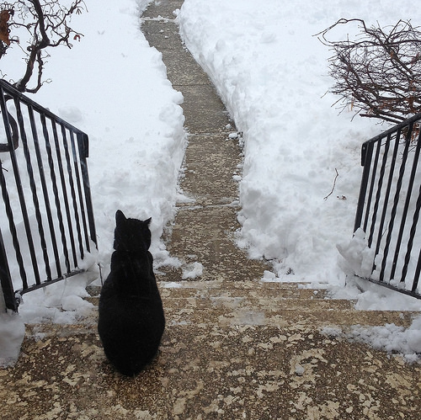
Hypothesis testing
An objective method of making decisions or inferences from sample data (evidence)
Sample data used to choose between two choices i.e. hypotheses or statements about a population
We typically do this by comparing what we have observed to what we expected if one of the statements (Null Hypothesis) was true
Notes:
The cat is faced with a decision! To go out into the snow or not since it looks cold and wet. It has two hypotheses; Null: it won’t get its paws wet and be cold, Alternative: It will get its paws wet and will be cold. It could base it’s decision on data it collected in its mind in the past; when it went out in the snow in the past it’s paws did get cold and wet and so may make the decision not to go out based on that evidence! Hypothesis testing pervades all of our lives all of the time without us realising it. We make decisions based on evidence. Sometimes they are the right ones and sometimes they are wrong. There is a chance of getting it wrong, so we develop strategies for minimising these risks of getting it wrong – this is the basics of the framework for hypothesis testing!

Slide 40
Hypothesis testing Framework What the text books might say!
Always two hypotheses:
H_{A}: Research (Alternative) Hypothesis
What we aim to gather evidence of
Typically that there is a difference/effect/relationship etc.
H₀: Null Hypothesis
What we assume is true to begin with
Typically that there is no difference/effect/relationship etc.
Notes:
This is what the text books say but to many students this language can be very inaccessible!
40

Slide 41
Discussion
How could you help a student understand what hypothesis testing is and why they need to use it?
Notes:
Ask audience for suggestions or ideas for how they may have done this in the past if they have. Or if not ask for ideas as to how they might approach this. Then move on to the court case idea.

Slide 42

Could try explaining things in the context of “The Court Case”?
Members of a jury have to decide whether a person is guilty or innocent based on evidence
Null: The person is innocent
Alternative: The person is not innocent (i.e. guilty)
The null can only be rejected if there is enough evidence to doubt it
i.e. the jury can only convict if there is beyond reasonable doubt for the null of innocence
They do not know whether the person is really guilty or innocent so they may make a mistake
Notes:
Ask what decisions are being made here and what errors could be made.

Slide 43
Types of Errors
Controlled via sample size (=1-Power of test)
Typically restrict to a 5% Risk
= level of significance
 | Study reports NO difference (Do not reject H₀) | Study reports IS a difference (Reject H₀)
H₀ is true Difference Does NOT exist in population
H_{A} is true Difference DOES exist in population
X
Type I Error
X
Type II Error
Prob of this = Power of test
Notes:
Before revealing all of this slide you could ask a few of the following questions:
What is the level of significance?
What is a Type I error? A Type II error?
What is a false positive?
What is statistical power?
You could you also ask how they would explain all of these things to a student?

Slide 44
Steps to undertaking a Hypothesis test
Define study question
Choose a suitable test
Set null and alternative hypothesis
Calculate a test statistic
Calculate a p-value
Make a decision and interpret your conclusions
Notes:
Point is to highlight the steps involved in undertaking a hypothesis test, but that the initial steps are often iterative when determining the research question(s) and the appropriate hypotheses and statistical tests to answer those questions.

Slide 45

Example: Titanic
The ship Titanic sank in 1912 with the loss of most of its passengers
809 of the 1,309 passengers and crew died
= 61.8%
Research question: Did class (of travel) affect survival?
Notes:
Ask the audience what the null and hypothesis might be, what type of data we would have and what test we should consider using.

Slide 46
Chi squared Test?
Null: There is NO association between
class and survival
Alternative: There IS an association between
class and survival
3 x 2
contingency table
Notes:
Since we have two categorical variables and want to know if they are associated we can use a chi-squared test. Class could be considered as an ordinal variable but there are only 3 levels here and so a chi-squared test therefore be quite appropriate. Point out there are 3 rows and 2 columns in our table and hence this is called a 3x2 contingency table. Discuss whether the table suggests class and survival are connected and try to tease out that we might be better looking at the % of 1st class passengers that died/survived and compare this with the % for 2nd class and 3rd class.

Slide 47
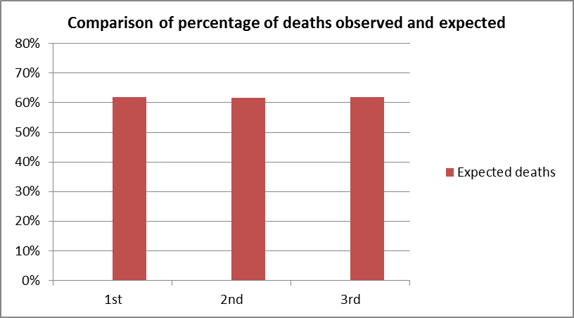
What would be expected if the null is true?
Same proportion of people would have died in each class!
Overall, 809 people died out of 1309 = 61.8%
Notes:
Discuss that this is what the % would be if there was no difference between the classes with respect to the chances of survival.

Slide 48
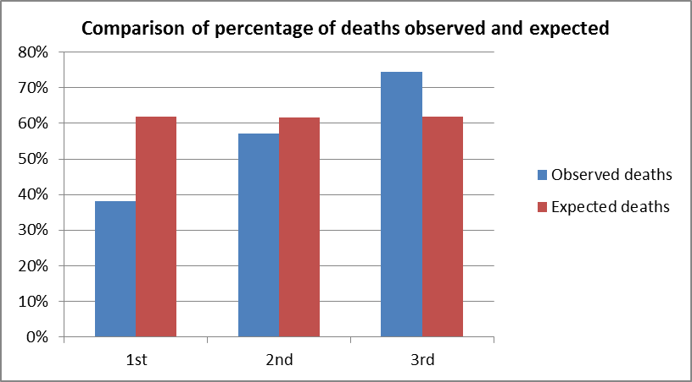
What would be expected if the null is true?
Same proportion of people would have died in each class!
Overall, 809 people died out of 1309 = 61.8%
Notes:
These show the % that were OBSERVED deaths in each class and are compared with the EXPECTED % shown in the previous slide. Discuss how the observed % for 1st class is the lowest whilst 3rd class is the highest.

Slide 49
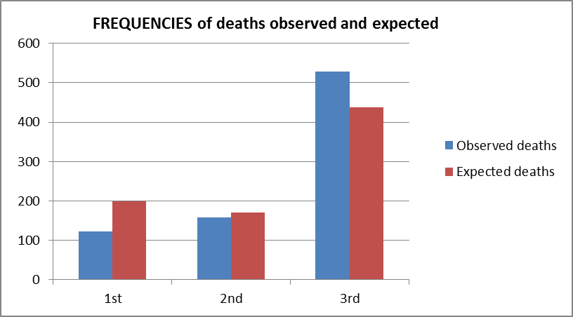
Chi-Squared Test Actually Compares Observed and Expected Frequencies
Expected number dying in each class = 0.618 * no. in class
Notes:
This slide is shown since the chi-squared test formally compares the observed FREQUENCIES with the expected frequencies.

Slide 50
Chi-squared test statistic
The chi-squared test is used when we want to see if two categorical variables are related
The test statistic for the Chi-squared test uses the sum of the squared differences between each pair of observed (O) and expected values (E)
Notes:
This is an optional slide if your session allowed time for this to be included and shows how the chi-squared test statistic compares the observed and expected.

Slide 51
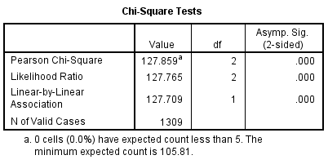
Using SPSS
Analyse → Descriptive Statistics → Crosstabs
Click on ‘Statistics’ button & select Chi-squared
Test Statistic = 127.859
p- value
p < 0.001
Note: Double clicking on the output will display the p-value to more decimal places
Notes:
Point these two key items of information out and also that the p-value is not zero! SPSS rounds the p-value to 3 d.p. Also comment on fact that SPSS reports NO leading zero in the p-values and so students will often write this as p=.000 but suggest they report it as p<0.001

Slide 52
Hypothesis Testing: Decision Rule
We can use statistical software to undertake a hypothesis test e.g. SPSS
One part of the output is the p-value (P)
If P < 0.05 reject H₀ => Evidence of H_{A} being true (i.e. IS association)
If P > 0.05 do not reject H₀ (i.e. NO association)
Notes:
What if p = 0.049 or 0.051? Discuss the fact that hypothesis testing involves weight of evidence and “shades of grey” rather than being a clear cut decision making process.

Slide 53
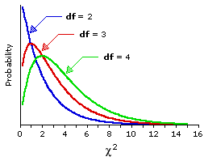
Chi squared distribution
The p-value is calculated using the Chi-squared distribution for this test
Chi-squared is a skewed distribution which varies depending on the degrees of freedom
Testing relationships between 2:
v = degrees of freedom
(no. of rows – 1) x (no. of columns – 1)
Note: One sample test:
v = df = outcomes – 1
Notes:
This slide is there to illustrate what the Chi-squared distribution looks like and that as the degrees of freedom increases (i.e. the amount of independent pieces of information we have from a study) then the more the wider the distribution is spread and becomes flatter.

Slide 54
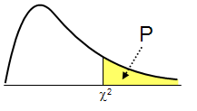
What’s a p-value? The technical answer!
Probability of getting a test statistic at least as extreme as the one calculated if the null is true
In Titanic example, the probability of getting a test statistic of 127.859 or above (if the null is true) is < 0.001
P-value p < 0.001
Distribution of test statistics
Our test Statistic = 127.859
Notes:
This is to discuss what the p-value actually is.

Slide 55
Interpretation
P-value
p < 0.001
Since p < 0.05 we reject the null
There is evidence (χ²₂=127.86, p < 0.001) to suggest that there is an association between class and survival
But… what is the nature of this association/relationship?
Test Statistic = 127.859
Notes:
As we square the differences in the test statistic, the chi squared test is always one tailed.

Slide 56
Titanic exercise
Were ‘wealthy’ people more likely to survive on board the Titanic?
Option 1:
Choose the right percentages from the next slide to investigate
Fill in the stacked bar chart with the chosen %’s
Write a summary to go with the chart
www.statstutor.ac.uk
Notes:
Student working slide. See solutions later!

Slide 57
Contingency tables exercise
Which percentages are better for investigating whether class had an effect on survival?
Column Row
65.3% of those who died were in 3rd class 74.5% of those in 3rd class died
Notes:
Discuss whether row or column % are most appropriate. We think row % are the right ones to consider – i.e. what are the % that died/survived in each class! See solution later!

Slide 58
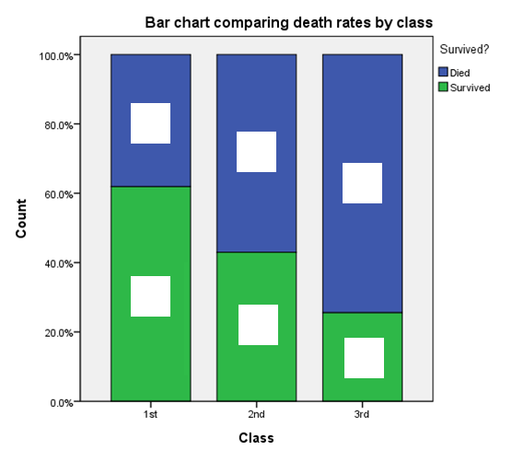
Did class affect survival? Question
Fill in the %’s on the stacked bar chart and interpret
www.statstutor.ac.uk
Notes:
Ask the audience to complete this slide. They will need to use the row % but you may want to let them decide that? See solution later!

Slide 59
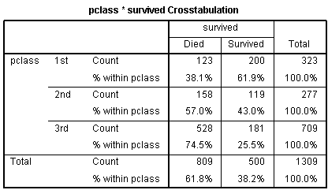
Did class affect survival? Solution
%’s within each class are preferable due to different class frequencies
Notes:
The question of interest is whether the class of an individual affected their chance of survival.
As there are different numbers in the classes, the percentages within those who died are misleading in option 1. There were 709 people in 3rd class but only 323 and 277 in 1st and 2nd class respectively so we would expect a higher % of 3rd class people in both the died and survived categories. It’s clear that people in the lower classes were much more likely to have died. 74.5% of those in 3rd class died but only 38.1% of those in 1st class.

Slide 60
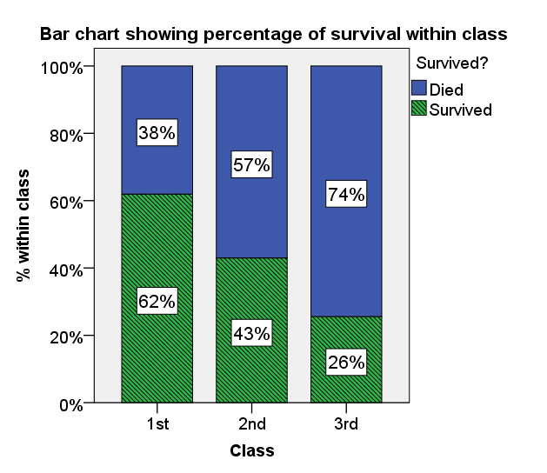
Did class affect survival? Solution
Data collected on 1309 passengers aboard the Titanic was used to investigate whether class had an effect on chances of survival. There was evidence (χ²₂=127.86, p < 0.001) to suggest that there is an association between class and survival.
Figure 1 shows that class and chances of survival were related. As class decreases, the percentage of those surviving also decreases from 62% in 1st Class to 26% in 3rd Class.
Figure 1: Bar chart showing % of passengers surviving within each class
Notes:
For contingency table data, a multiple or stacked bar chart can be used based on frequencies or percentage within. Adding labels with the % to charts can be helpful.
When summarising data, encourage students not to include every table and graph and do not comment on every frequency or percentage. Think back to their original question of interest and answer that question and talk about every table/ graph you include in your report.

Slide 61
Low EXPECTED Cell Counts with the Chi-squared test
 | Died | Survived | Total
1st Class | 200 | 123 | 323
2nd Class | 171 | 106 | 277
3rd Class | 438 | 271 | 709
Total | 809 | 500 | 1,309
We have no cells with expected counts below 5
SPSS Output
Notes:
Point out that we have no cells with low cell counts, but the that the chi-squared test is invalidated if there are more than 20% (1 in 5) cells with EXPECTED cell counts below 5 – SPSS reports this %

Slide 62
Low Cell Counts with the Chi-squared test
Check no. of cells with EXPECTED counts less than 5
SPSS reports the % of cells with an expected count <5
If more than 20% then the test statistic does not approximate a chi-squared distribution very well
If any expected cell counts are <1 then cannot use the chi-squared distribution
In either case if have a 2x2 table use Fishers’ Exact test (SPSS reports this for 2x2 tables)
In larger tables (3x2 etc.) combine categories to make cell counts larger (providing it’s meaningful)
Notes:
Discuss what to do if there are low expected cell counts.

Slide 63
Comparing means
community project
encouraging academics to share statistics support resources
All stcp resources are released under a Creative Commons licence
Ellen Marshall / Alun Owen
University of Sheffield / University of Worcester
Reviewer: Ruth Fairclough
University of Wolverhampton

Slide 64
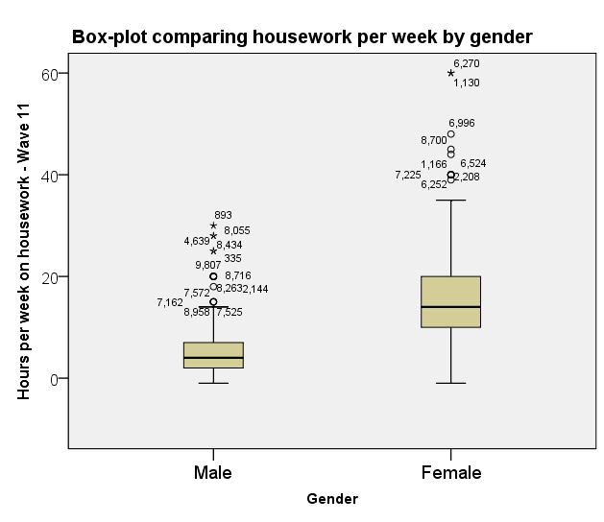
Summarising means
Calculate summary statistics by group
Look for outliers/ errors
Use a box-plot or confidence interval plot
www.statstutor.ac.uk
Notes:
Use this slide to point out that when comparing two groups with respect to their means, then box plots are useful as an exploratory tool to check for outliers.

Slide 65
T-tests Paired or Independent (Unpaired) Data?
T-tests are used to compare two population means
Paired data: same individuals studied at two different times or under two conditions PAIRED T-TEST
Independent: data collected from two separate groups INDEPENDENT SAMPLES T-TEST
Notes:
We are often interested in comparing two sets of data, prior to analysis you must determine whether this data is paired or independent
Paired data arises when the same individuals are studied twice. For example taken a measurement before treatment, giving treatment and then assessing the subject again.
There is another situation when paired data arises and that is when subjects have been individually matched through experimental design. Such as in a matched case control study. For example, twin studies, an eye treatment where one eye could be considered as control.
Two separate groups (independent group) require different analysis

Slide 66
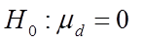
Comparison of hours worked in 1988 to today
Paired or unpaired?
If the same people have reported their hours for 1988 and 2014 have PAIRED measurements of the same variable (hours)
Paired Null hypothesis: The mean of the paired differences = 0
If different people are used in 1988 and 2014 have independent measurements
Independent Null hypothesis: The mean hours worked in 1988 is equal to the mean for 2014
Notes:
Two examples of a paired and independent situation when comparing means

Slide 67
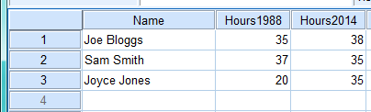

SPSS data entry
Paired Data
Independent Groups
Notes:
How to enter the data in these two situations and that they need to be handled differently in SPSS.

Slide 68
What is the t-distribution?
The t-distribution is similar to the standard normal distribution but has an additional parameter called degrees of freedom (df or v)
For a paired t-test, v = number of pairs – 1
For an independent t-test,
Used for small samples and when the population standard deviation is not known
Small sample sizes have heavier tails
www.statstutor.ac.uk
Notes:
The t-distribution is similar to the standard normal distribution but has an additional parameter called degrees of freedom (df)
The degrees of freedom is calculated as the number of observations – 1 and is often referred to as v in many t-tables.
When we have small sample sizes (n < 30), we replace the normal distribution with Student’s t distribution, which has slightly less probability of being close to the mean and a somewhat larger probability of being in the tails. As the sample size increases, the critical values tend towards those of the normal distribution e.g. for a two tailed test with 5% significance, the critical value gets closer to 1.96, as the sample size increases.

Slide 69
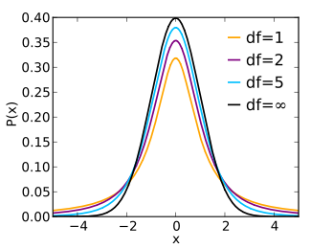
Relationship to normal
As the sample size gets big, the t-distribution matches the normal distribution
Normal curve
www.statstutor.ac.uk
Notes:
As the sample size increase the df increases and the t-dist becomes more like the standard normal distribution.

Slide 70
CAST e-books in statistics: t-distribution
http://cast.massey.ac.nz/collection_public.html
Introductory e-book (general) and select
10. Testing Hypotheses
3. Tests about means
4. The t-distribution
5. The t-test for a mean
Notes:
CAST has lots of good JAVA applets that can demonstrate many statistical concepts very effectively.

Slide 71
Exercise
For Examples 1 and 2 (on the following four slides) discuss the answers to the following:
State a suitable null hypothesis
State whether it’s a Paired or Independent Samples t-test
Decide whether to reject the null hypothesis
State a conclusion in words
Notes:
Ask the group to think about the answers to these two exercises in pairs and then go through the solutions with the whole group.

Slide 72
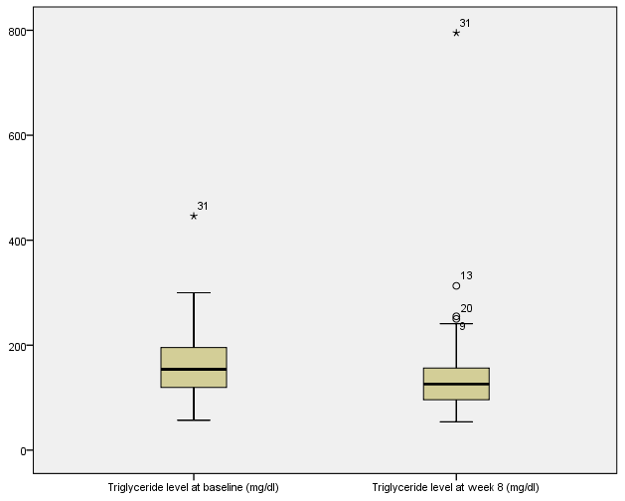
Example 1: Triglycerides
In a weight loss study, Triglyceride levels were measured at baseline and again after 8 weeks of taking a new weight loss treatment.

Slide 73
Example 1: t-Test Results
 |  |  |  |  |  | t | df | Sig. (2-tailed)
 | Mean | Std. Deviation | Std. Error Mean | 95% Confidence Interval of the Difference
 |  |  |  | Lower | Upper
Triglyceride level at week 8 (mg/dl) - Triglyceride level at baseline (mg/dl) | -11.371 | 80.360 | 13.583 | -38.976 | 16.233 | -.837 | 34 | .408
Null Hypothesis is:
P-value =
Decision (circle correct answer): Reject Null/ Do not reject Null
Conclusion:

Slide 74
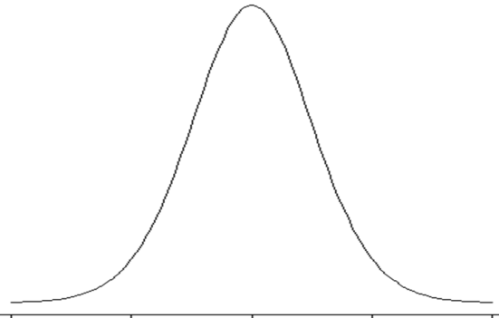
Example 1: Solution
 |  |  |  |  |  | t | df | Sig. (2-tailed)
 | Mean | Std. Deviation | Std. Error Mean | 95% Confidence Interval of the Difference
 |  |  |  | Lower | Upper
Triglyceride level at week 8 (mg/dl) - Triglyceride level at baseline (mg/dl) | -11.371 | 80.360 | 13.583 | -38.976 | 16.233 | -.837 | 34 | .408
As p > 0.05, do NOT reject the null
NO evidence of a difference in the mean triglyceride before and after treatment
P(t< -0.837)
=0.204
P(t>0.837)
=0.204
-0.837
0.837

Slide 75
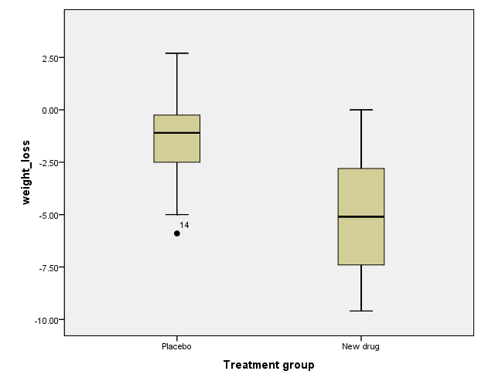
Example 2: Weight Loss
Weight loss was measured after taking either a new weight loss treatment or placebo for 8 weeks
Treatment group | N | Mean | Std. Deviation
Placebo | 19 | -1.36 | 2.148
New drug | 18 | -5.01 | 2.722

Slide 76
Example 2: t-Test Results
Ignore the shaded part of the output for now!
 | Levene's Test for Equality of Variances |  | T-test results |  |  |  |  | 95% CI of the Difference
 | F | Sig. | t | df | Sig. (2-tailed) | Mean Difference | Std. Error Difference | Lower | Upper
Equal variances assumed | 2.328 | .136 | 4.539 | 35 | .000 | 3.648 | .804 | 2.016 | 5.280
Equal variances not assumed |  |  | 4.510 | 32.342 | .000 | 3.648 | .809 | 2.001 | 5.295
Null Hypothesis is:
P-value =
Decision (circle correct answer): Reject Null/ Do not reject Null
Conclusion:

Slide 77
Example 2: Solution
Ignore the shaded part of the output for now!
 | Levene's Test for Equality of Variances |  | T-test results |  |  |  |  | 95% CI of the Difference
 | F | Sig. | t | df | Sig. (2-tailed) | Mean Difference | Std. Error Difference | Lower | Upper
Equal variances assumed | 2.328 | .136 | 4.539 | 35 | .000 | 3.648 | .804 | 2.016 | 5.280
Equal variances not assumed |  |  | 4.510 | 32.342 | .000 | 3.648 | .809 | 2.001 | 5.295
H₀: μ_{new} = μ_{placebo}
As p < 0.05, DO reject the null
IS evidence of a difference in weight loss between treatment and placebo
P(t< -4.539)
Is < 0.001
P(t>4.539)
Is < 0.001
-4.539
4.539

Slide 78
Assumptions
Every test has assumptions
Tutors quick guide shows assumptions for each test and what to do if those assumptions are not met
Notes:
The MASH Centre at the University of Sheffield have produced a useful booklet called the “tutor quick guide booklet” which is available at www.statstutor.ac.uk and contains details of the assumptions made in a lot of the standard statistical tests commonly used.

Slide 79
Assumptions in t-Tests
Normality: Plot histograms
One plot of the paired differences for any paired data
Two (One for each group) for independent samples
Don’t have to be perfect, just roughly symmetric
Equal Population variances: Compare sample standard deviations
As a rough estimate, one should be no more than twice the other
Do an F-test (Levene’s in SPSS) to formally test for differences
However the t-test is very robust to violations of the assumptions of Normality and equal variances, particularly for moderate (i.e. >30) and larger sample sizes
Notes:
Suggests ways of checking the assumptions in a t-test. For paired data it is the single column of differences that are assumed to be normal not each set of data from the two time points. The equal variances assumption does not apply to the paired t-test since there is only one sample (and population!)

Slide 80
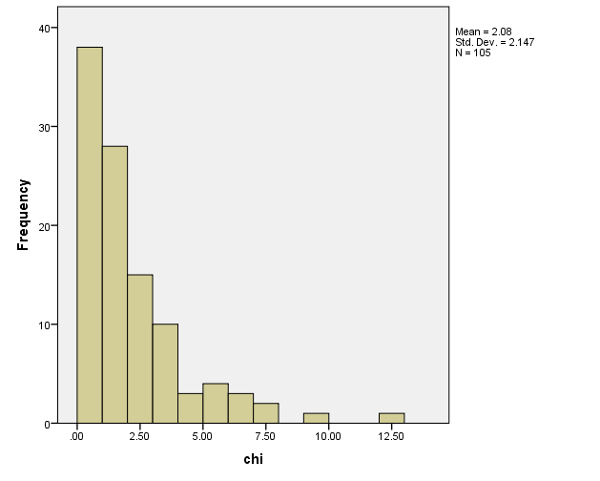
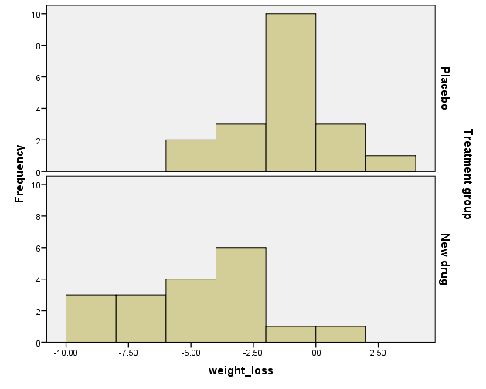
Histograms from Examples 1 and 2
Do these histograms look approximately normally distributed?
Notes:
Ask the group for comments. Make the point that for small samples it can be hard to tell. The histogram on the left is indicates a problem but those on the right are approximately normally distributed.

Slide 81
Levene’s Test for Equal Variances from Examples 2
 | Levene's Test for Equality of Variances |  | T-test results |  |  |  |  | 95% CI of the Difference
 | F | Sig. | t | df | Sig. (2-tailed) | Mean Difference | Std. Error Difference | Lower | Upper
Equal variances assumed | 2.328 | .136 | 4.539 | 35 | .000 | 3.648 | .804 | 2.016 | 5.280
Equal variances not assumed |  |  | 4.510 | 32.342 | .000 | 3.648 | .809 | 2.001 | 5.295
Null hypothesis is that pop variances are equal
i.e. H₀: σ²_{new} = σ²_{placebo}
Since p = 0.136 and so is >0.05 we do not reject the null
i.e. we can assume equal variances ☺
Notes:
Explain how Levene’s test works and that its not a problem if the assumption of equal variances is rejected as we simply use the second row in the table with the modified t-test results to test for the difference between the means.

Slide 82
What if the assumptions are not met?
There are alternative tests which do not have these assumptions
Test | Check | Equivalent non-parametric test
Independent t-test | Histograms of data by group | Mann-Whitney
Paired t-test | Histogram of paired differences | Wilcoxon signed rank
Notes:
You could say that we’ll talk about these non-parametric tests in more detail later

Slide 83
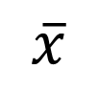
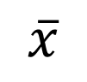
Sampling Variation
Every sample taken from a population, will contain different numbers so the mean varies.
Which estimate is most reliable?
How certain or uncertain are we?
Sample A
n=20
Mean = 277
$$\overline{x}$$
Population
Mean = ?
SD =?
Sample B
n=50
Mean = 274
$$\overline{x}$$
Sample C
n=300
Mean = 275
$$\overline{x}$$
Notes:
Point is that your data will vary from study to study and so the sample mean etc. has a sampling distribution. Even of the data is not normal this will look more normal when the sample size is medium or large (i.e. >30).

Slide 84
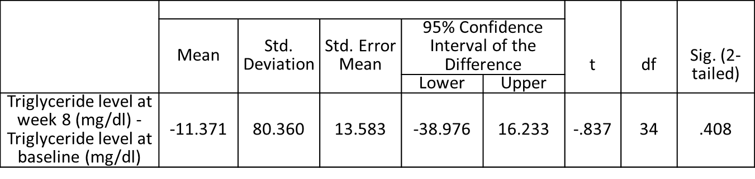
Confidence Intervals
A range of values within which we are confident (in terms of probability) that the true value of a pop parameter lies
A 95% CI is interpreted as 95% of the time the CI would contain the true value of the pop parameter
i.e. 5% of the time the CI would fail to contain the true value of the pop parameter
Notes:
Discuss the interpretation of the CI in the above and also comment on how this relates to the conclusion drawn from the earlier (equivalent) hypothesis test.

Slide 85
CAST e-books in statistics: Confidence Intervals
http://cast.massey.ac.nz/collection_public.html
Choose introductory e-book (general) and select
9. Estimating Parameters
3. Conf. Interval for mean
6. Properties of 95% C.I.
Notes:
Again CAST is very useful for demonstrating CI’s etc.

Slide 86
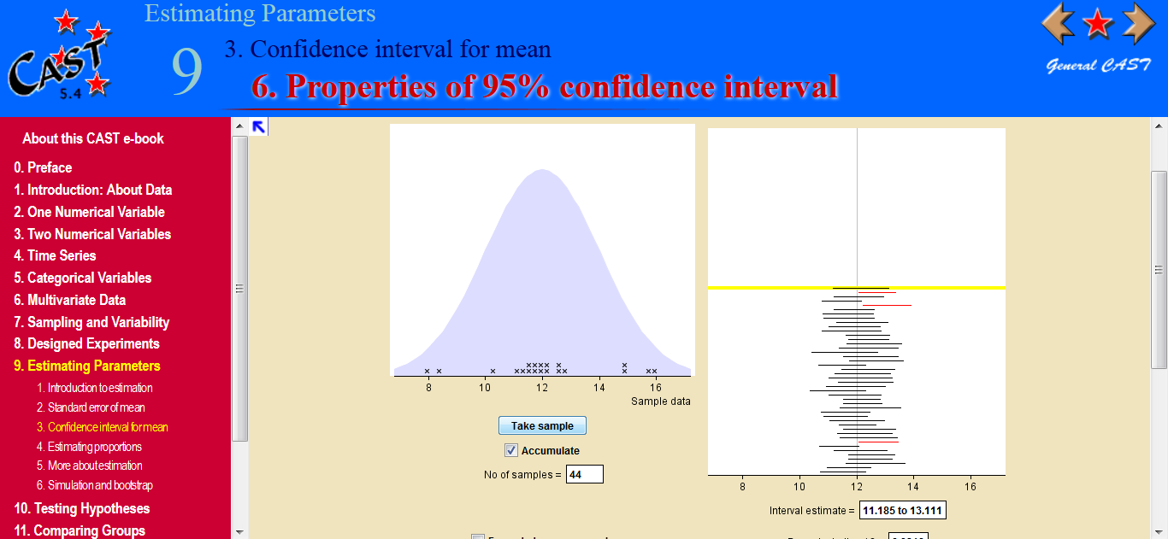
Confidence Interval simulation from CAST
Population mean
Seven do not include 141.1mmHg - we would expect that the 95% CI will not include the true population mean 5% of the time
Notes:
18
This is a screen shot from CAST

Slide 87
Exercise
Discuss what the interpretation is for the confidence interval from Example 2 (Weight loss was measured after taking either a new weight loss treatment or placebo for 8 weeks) highlighted below:
 | Levene's Test for Equality of Variances |  | T-test results |  |  |  |  | 95% CI of the Difference
 | F | Sig. | t | df | Sig. (2-tailed) | Mean Difference | Std. Error Difference | Lower | Upper
Equal variances assumed | 2.328 | .136 | 4.539 | 35 | .000 | 3.648 | .804 | 2.016 | 5.280
Notes:
Give the group a few moments to consider this and then go through the solution.

Slide 88
Exercise: Solution
Discuss what the interpretation is for the confidence interval from Example 2 highlighted below:
 | Levene's Test for Equality of Variances |  | T-test results |  |  |  |  | 95% CI of the Difference
 | F | Sig. | t | df | Sig. (2-tailed) | Mean Difference | Std. Error Difference | Lower | Upper
Equal variances assumed | 2.328 | .136 | 4.539 | 35 | .000 | 3.648 | .804 | 2.016 | 5.280
The true mean weight loss would be between about 2 to 5 kg with the new treatment.
This is always positive hence the hypothesis test rejected the null that the difference is zero
Notes:
Solution.

Slide 89
Investigating relationships
community project
encouraging academics to share statistics support resources
All stcp resources are released under a Creative Commons licence
Ellen Marshall / Alun Owen
University of Sheffield / University of Worcester
Reviewer: Ruth Fairclough
University of Wolverhampton
Notes:
This section covers correlation and regression.

Slide 90
Two categorical variables
Are boys more likely to prefer maths and science than girls?
Variables:
Favourite subject (Nominal)
Gender (Binary/ Nominal)
Summarise using %’s/ stacked or multiple bar charts
Test: Chi-squared
Tests for a relationship between two categorical variables
Notes:
We’ve already looked at a chi-squared test which looked for an association between survival and class on the Titanic. The chi-squared test looks for an association between two categorical variables. Another example is looking at whether boys are more likely to prefer maths and science subjects than girls. You could ask students which subject was their favourite subject (nominal) and note whether they were male and female (binary). You could then summarise the sample data using a stacked/ multiple bar chart and test for a relationship in the population using a chi-squared test.

Slide 91
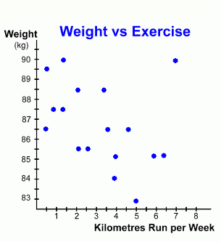
Scatterplot
Relationship between two scale variables:
Explores the way the two co-vary: (correlate)
Positive / negative
Linear / non-linear
Strong / weak
Presence of outliers
Statistic used:
r = correlation coefficient
Outlier
Linear
Notes:
The scatter graph or scatterplot is one of the most common graphs in statistics. It is used to explore the relationship between two scale variables. Here we see the relationship between how far a person runs each week and their weight. Each point represents a person.
Is there a linear or non-linear pattern?
Is the relationship positive or negative (is there an uphill or downhill slope)?
Is the relationship, strong (points close to the line) or weak (random scatter)?
A scatterplot will help answer these questions. It will also help detect any outliers, which do not follow the general trend. Here there is one outlier (someone who weighs a lot but also runs a lot)

Slide 92
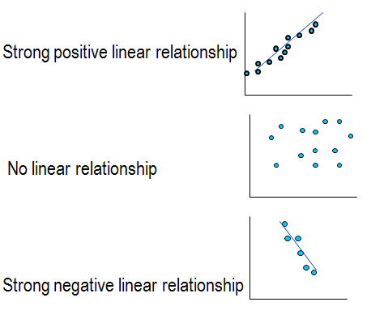
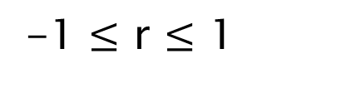
Correlation Coefficient r
Measures strength of a relationship between two continuous variables
-1 $≤$ r $≤$ 1
r = 0.9
r = 0.01
r = -0.9
www.statstutor.ac.uk
Notes:
Correlation quantifies this relationship. Correlation coefficients range from -1 and +1 with 0 meaning there is no relationship at all (see middle graph). The further away from 0 the coefficient is, the stronger the relationship. A positive number means that as x increases, so does y and negative coefficients that y decreases as x increases.
Here are some examples. The first shows strong positive correlation, the second no relationship and the 3rd a strong negative relationship.

Slide 93
Correlation Interpretation
An interpretation of the size of the coefficient has been described by Cohen (1992) as:
Cohen, L. (1992). Power Primer. Psychological Bulletin, 112(1) 155-159
Correlation coefficient value | Relationship
-0.3 to +0.3 | Weak
-0.5 to -0.3 or 0.3 to 0.5 | Moderate
-0.9 to -0.5 or 0.5 to 0.9 | Strong
-1.0 to -0.9 or 0.9 to 1.0 | Very strong
www.statstutor.ac.uk
Notes:
Students often need to interpret the coefficient and like to have guidelines for deciding on the strength of the relationship. There are alternative guidelines available but we use Cohen’s to interpret as weak, moderate and strong relationships.

Slide 94
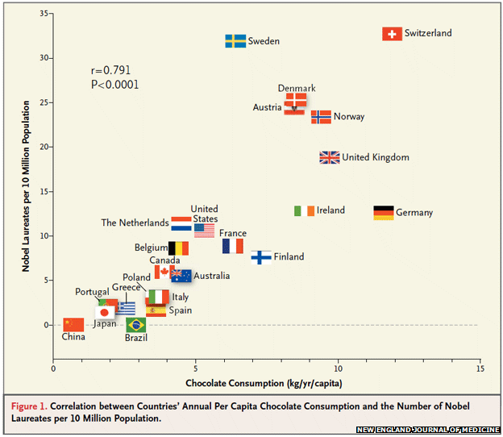
Does chocolate make you clever or crazy?
A paper in the New England Journal of Medicine claimed a relationship between chocolate and Nobel Prize winners
http://www.nejm.org/doi/full/10.1056/NEJMon1211064
r = 0.791
www.statstutor.ac.uk
Notes:
A paper was published stating that there was a relationship between eating the chocolate consumption of a country and Nobel prize winners. What else is related to chocolate??

Slide 95

Chocolate and serial killers
What else is related to chocolate consumption?
http://www.replicatedtypo.com/chocolate-consumption-traffic-accidents-and-serial-killers/5718.html
r = 0.52
www.statstutor.ac.uk
Notes:
Apparently, the number of serial killers! This was a reply to the paper making the first claim.

Slide 96
Hypothesis tests for r
Tests the null hypothesis that the population correlation r = 0 NOT that there is a strong relationship!
It is highly influenced by the number of observations e.g. sample size of 150 will classify a correlation of 0.16 as significant!
Better to use Cohen’s interpretation
www.statstutor.ac.uk
Notes:
There are tests for correlation coefficients but students often misinterpret them. They think that a significant result means that there is a strong relationship when the test really tests the hypothesis that r = 0. A significant result just means that there is evidence to suggest that r is not 0. Sample size plays a big part in determining what level of r is significant. The larger the sample size, the lower the coefficent needs to be to be significant. With a sample of 150, a correlation of 0.16 will be significant.

Slide 97
Exercise
Interpret the following correlation coefficients using Cohen’s and explain what it means
Relationship | Correlation
Average IQ and chocolate consumption | 0.27
Road fatalities and Nobel winners | 0.55
Gross Domestic Product and Nobel winners | 0.7
Mean temperature and Nobel winners | -0.6
www.statstutor.ac.uk
Notes:
Allow the students time to try these questions on their own.
Here are some more chocolate/ nobel prize winner related correlation coefficients to interpret. Use Cohen’s to interpret the coefficients. Which ones are meaningful?

Slide 98
Exercise - solution
Relationship | Correlation | Interpretation
Average IQ and chocolate consumption | 0.27 | Weak positive relationship. More chocolate per capita = higher average IQ
Road fatalities and Nobel winners | 0.55 | Strong positive. More accidents = more prizes!
Gross Domestic Product and Nobel winners | 0.7 | Strong positive. Wealthy countries = more prizes
Mean temperature and Nobel winners | -0.6 | Strong negative. Colder countries = more prizes.
www.statstutor.ac.uk
Notes:
Go through the answers after giving the students a few minutes to try the questions on their own

Slide 99
Confounding
Is there something else affecting both chocolate consumption and Nobel prize winners?
Chocolate consumption
Number of Nobel winners
GDP (wealth)
Temperature
www.statstutor.ac.uk
Notes:
When looking into correlations, it’s possible that a relationship between two variables may actually be caused by something else related to both. These are called confounding variables. In the case of chocolate consumption and nobel prize winners, the GDP and average temperature of a country are related to both chocolate consumption and nobel prize winners and it’s this relationship that is being measured with the correlation.

Slide 100

Dataset for today
Factors affecting birth weight of babies
Mother smokes = 1
Standard gestation = 40 weeks
www.statstutor.ac.uk
Notes:
The dataset being used for the following slides is a sample from a larger data set containing information on babies. There are measurements of the baby at birth (such as birth weight and gestational age) and of their parents (height and weight of mother as well as whether or not they smoked).

Slide 101

Exercise: Gestational age and birth weight
Describe the relationship between the gestational age of a baby and their weight at birth.
r = 0.706
Draw a line of best fit through the data (with roughly half the points above and half below)
www.statstutor.ac.uk
Notes:
Student exercise.
Describe the relationship between gestational age and birth weight. Put a line of best fit through the data so that roughly half the points are above and below the lines.

Slide 102

Exercise - Solution
Describe the relationship between the gestational age of a baby and their weight at birth.
There is a strong positive relationship which is linear
www.statstutor.ac.uk
Notes:
Solution. There is a strong positive relationship between birthweight and gestational age.

Slide 103
Regression: Association between two variables
Regression is useful when we want to
look for significant relationships between two variables
predict a value of one variable for a given value of the other
It involves estimating the line of best fit through the data which minimises the sum of the squared residuals
What are the residuals?
www.statstutor.ac.uk
Notes:
Regression produces an equation for the line of best fit. The equation can be used to predict values for the dependent variable given the independent variable. More commonly students use regression to look for significant relationships. The computer classifies the line of best fit which minimises the sum of the squared residuals but what are the residuals?

Slide 104

Residuals
Residuals are the differences between the observed and predicted weights
Residuals
Baby heavier than predicted
Baby lighter than expected
Regression line
Baby the same as predicted
X Predictor / explanatory variable (independent variable)
www.statstutor.ac.uk
Notes:
Residuals are the differences between the observed dependent variables and the predicted value from the regression equation. These residuals are squared and added together.

Slide 105
Regression
Simple linear regression looks at the relationship between two Scale variables by producing an equation for a straight line of the form
Which uses the independent variable to predict the dependent variable
Independent variable
Dependent variable
Intercept
Slope
www.statstutor.ac.uk
Notes:
Regression produces a line of this form where alpha is the intercept and beta is the slope. Students may struggle with this if they have not studied maths so it’s important to give numerical examples. They may not be interested in this either as they are just using regression to find significant relationships.

Slide 106

Hypothesis testing
We are often interested in how likely we are to obtain our estimated value of if there is actually no relationship between x and y in the population
One way to do this is to do a test of significance for the slope
www.statstutor.ac.uk
Notes:
The hypothesis test in regression involves testing that the slope is 0. This means that every baby would be classified as the same weight irrelevant of what gestational age they are.
How good do you think a model with a slope of 0 would fit this data? Would you reject the null straight away?

Slide 107

Output from SPSS
Key regression table:
As p < 0.05, gestational age is a significant predictor of birth weight. Weight increases by 0.36 lbs for each week of gestation.
Y = -6.66 + 0.36x
P – value < 0.001
www.statstutor.ac.uk
Notes:
The key table from the regression output in SPSS contains the slope and intercept of the regression line as well as the hypothesis tests. The coefficients of the line are in the column headed B (Unstandardised Coefficients) so the estimated regression equation is y =-6.66 + 0.36x and the slope is significant. (p < 0.001). If students are not interested in predicting using the equation, they just need to report the p-value and interpret the coefficient for the slope e.g. weight increases by 0.36 lbs for each extra week gestation. Note: 2 dp is enough when reporting

Slide 108

How reliable are predictions? – R²
How much of the variation in birth weight is explained by the model including Gestational age?
Proportion of the variation in birth weight explained by the model R² = 0.499 = 50%
Predictions using the model are fairly reliable.
Which variables may help improve the fit of the model?
Compare models using Adjusted R²
www.statstutor.ac.uk
Notes:
Another important value contained in the output is R squared. This is a measure of how well the model fits the data and therefore how reliable predictions are. For simple linear regression, R squared is just the correlation coefficient squared. It therefore takes values between 0 and 1. Turning it into a percentage makes it easier to explain. Here 50% of the variation in birthweight is explained by the model including gestational age. This is quite good for a model containing only one independent variable. What constitutes ‘good’ varies by discipline.

Slide 109
Assumptions for regression
Assumption | Plot to check
The relationship between the independent and dependent variables is linear. | Original scatter plot of the independent and dependent variables
Homoscedasticity: The variance of the residuals about predicted responses should be the same for all predicted responses. | Scatterplot of standardised predicted values and residuals
The residuals are independently normally distributed | Plot the residuals in a histogram
Look for patterns.
www.statstutor.ac.uk
Notes:
There are several assumptions for regression. The first is that the relationship between continuous dependent and independent variables is linear which is confirmed using a scatterplot. The second two are available on request from SPSS through the ‘Plots’ section of the regression. The first assesses whether the spread of residuals varies depending on the predicted values and the second whether the residuals are normally distributed.

Slide 110

Checking normality
Histogram of the residuals looks approximately normally distributed
When writing up, just say ‘normality checks were carried out on the residuals and the assumption of normality was met’
Outliers are outside
www.statstutor.ac.uk
Notes:
Here’s the histogram of residuals for the birthweight and gestational age model. The residuals only have to be approximately normally distributed so only histograms showing serious skew are a problem. Students don’t need to include the plots for checking normality in their main report. They just need to say that the checks were carried out.

Slide 111

Predicted values against residuals
Are there any patterns as the predicted values increases?
There is a problem with Homoscedasticity if the scatter is not random. A “funnelling” shape such as this suggests problems.
www.statstutor.ac.uk
Notes:
This plot shows predicted values on the x axis and residuals on the y axis. What we want is random scatter with no patterns. One problem to look for is an increase in the width of the scatter as predicted values increase.

Slide 112

What if assumptions are not met?
If the residuals are heavily skewed or the residuals show different variances as predicted values increase, the data needs to be transformed
Try taking the natural log (ln) of the dependent variable. Then repeat the analysis and check the assumptions
www.statstutor.ac.uk
Notes:
Here are some examples of problem data. The histogram on the left shows residuals that are very positively skewed and the plot on the right shows an increase in variability of the residuals as predicted values increase. The dependent variable needs to be transformed and the most common transformation is to take the log of the dependent variable. The analysis is re-run using the transformed variable and the assumptions checked again. The downside to this is the interpretation of the output changes and some students will struggle with the interpretation.

Slide 113
Exercise
Investigate whether mothers pre-pregnancy weight and birth weight are associated using a scatterplot, correlation and simple regression.
www.statstutor.ac.uk
Notes:
Student exercise with the next 3 slides for them to fill in.

Slide 114

Exercise - scatterplot
Describe the relationship using the scatterplot and correlation coefficient
r = 0.39
www.statstutor.ac.uk

Slide 115

Regression question
Pre-pregnancy weight p-value:
Regression equation:
Interpretation:
R² = 0.152
Does the model result in reliable predictions?
www.statstutor.ac.uk

Slide 116


Check the assumptions
www.statstutor.ac.uk

Slide 117
Correlation
Pearson’s correlation = 0.39
Describe the relationship using the scatterplot and correlation coefficient
There is a moderate positive linear relationship between mothers’ pre-pregnancy weight and birth weight (r = 0.39). Generally, birth weight increases as mothers weight increases
www.statstutor.ac.uk
Notes:
Solution

Slide 118
Regression
Pre-pregnancy weight p-value: p = 0.011
Regression equation: y = 3.16 + 0.03x
Interpretation:
There is a significant relationship between a mothers’ pre-pregnancy weight and the weight of her baby (p = 0.011). Pre-pregnancy weight has a positive affect on a baby’s weight with an increase of 0.03 lbs for each extra pound a mother weighs.
Does the model result in reliable predictions?
Not really. Only 15.2% of the variation in birth weight is accounted for using this model.
www.statstutor.ac.uk
Notes:
Solution

Slide 119
Checking assumptions
Linear relationship
Histogram roughly peaks in the middle
No patterns in residuals
www.statstutor.ac.uk
Notes:
Solution

Slide 120
Multiple regression
Multiple regression has several binary or Scale independent variables
Categorical variables need to be recoded as binary dummy variables
Effect of other variables is removed (controlled for) when assessing relationships
www.statstutor.ac.uk
Notes:
Multiple regression is an extension to simple linear regression with multiple independent variables. Although regression only takes scale and binary variables, categorical variables with 3+ categories can be recoded a binary dummy variables. For example, marital status could be recoded as Are you married yes/ no, are you single yes/ no etc
One of the good things about multiple regression is that when assessing the significance of a particular independent variable, the effect due to the other variables is removed/ controlled for first. For example, in medical trials looking for a difference between treatments, the effects of factors such as age and weight are controlled for when assessing the difference. This ensures that any significant difference is due to the treatment rather than differences in patients within each group.

Slide 121
Multiple regression
What affects the number of Nobel prize winners?
Dependent: Number of Nobel prize winners
Possible independents: Chocolate consumption, GDP and mean temperature
Chocolate consumption is significantly related to Nobel prize winners in simple linear regression
Once the effect of a country’s GDP and temperature were taken into account, there was no relationship
www.statstutor.ac.uk
Notes:
Here’s an example. When looking into what affects the number of Nobel prize winners, simple regression showed significant evidence of a relationship between chocolate consumption and Nobel prize winners. However, when the GDP and average temperature of a country were taken into account, chocolate was found not to be significant.

Slide 122
Multiple regression
In addition to the standard linear regression checks, relationships BETWEEN independent variables should be assessed
Multicollinearity is a problem where continuous independent variables are too correlated (r > 0.8)
Relationships can be assessed using scatterplots and correlation for scale variables
SPSS can also report collinearity statistics on request. The VIF should be close to 1 but under 5 is fine whereas 10 + needs checking
www.statstutor.ac.uk
Notes:
Multiple regression has the same assumptions as simple regression but has one extra. If two independent variables are strongly correlated, they are less likely to be significant. This effect is called multicollinearity. Before running multiple regression, check the correlations between the dependent and all scale dependents. Look for independents that are strongly correlated with the dependent to include in the model but also for variables related to each other. Common errors are including weight and BMI for example. If r between independents is above 0.8, only one should be included in the model. For further checks, SPSS will provide multicollinearity statistics in the output for each variable. The VIF column displays a number which should be under 1 but under 5 is usually fine. If the number is more than 10, remove that variable and run the regression again.

Slide 123

Exercise
Which variables are most strongly related?
www.statstutor.ac.uk
Notes:
Here are correlations between birth weight and some possible independents. Which independents are most related to birth weight and to each other?

Slide 124
Exercise - Solution
Which variables are most strongly related?
Gestation and birth weight (0.709)
Mothers height and weight (0.671)
Mothers height and weight are strongly related. They don’t exceed the problem correlation of 0.8 but try the model with and without height in case it’s a problem.
When both were included in regression, neither were significant but alone they were
www.statstutor.ac.uk
Notes:
Solution

Slide 125
Logistic regression
Logistic regression has a binary dependent variable
The model can be used to estimate probabilities
Example: insurance quotes are based on the likelihood of you having an accident
Dependent = Have an accident/ do not have accident
Independents: Age (preferably Scale), gender, occupation, marital status, annual mileage
Ordinal regression is for ordinal dependent variables
www.statstutor.ac.uk
Notes:
There are a number of different types of regression for different types of dependent variable but most are beyond the scope of the average student. One which is commonly used is logistic regression which has a binary dependent variable. The model can be used to estimate probabilities although as with regression, students are usually just looking for significant relationships. A common use for this type of model is used by insurance companies. Using your details, the likelihood of you having a crash is estimated when your insurance premium is calculated. Ordinal regression is for dependents with more that 2 categories but for a lot of students, seeing if they can reduce the categories to 2 to use logistic regression may be easier for them

Slide 126
Choosing the right test
community project
encouraging academics to share statistics support resources
All stcp resources are released under a Creative Commons licence
Ellen Marshall / Alun Owen
University of Sheffield / University of Worcester
Reviewer: Ruth Fairclough
University of Wolverhampton

Slide 127
Choosing the right test
One of the most common queries in stats support is ‘Which analysis should I use’
There are several steps to help the student decide
When a student is explaining their project, these are the questions you need answers for
www.statstutor.ac.uk
Notes:
This section discusses one of the most common questions in stats support – ‘Which analysis should I use?’. Even if they think they know the analysis to use, when they explaining their project, you need to be thinking of the appropriate analysis anyway.

Slide 128
Choosing the right test
A clearly defined research question
What is the dependent variable and what type of variable is it?
How many independent variables are there and what data types are they?
Are you interested in comparing means or investigating relationships?
Do you have repeated measurements of the same variable for each subject?
www.statstutor.ac.uk
Notes:
When a student explains their project, you are listening out for the answers to these questions. If they start to waffle, try to steer them back to giving you this information but be prepared to explain the terminology e.g. dependent/ outcome variable and data types. The key thing is the data types of the dependent and independent variables.

Slide 129
Research question
Clear questions with measurable quantities
Which variables will help answer these questions
Think about what test is needed before carrying out a study so that the right type of variables are collected
www.statstutor.ac.uk
Notes:
Students will not usually have a clear research question written in terms of the possible variables but they may have an idea about the analysis they want to do so you will need to listen carefully to their project and help them identify the hypothesis. Ideally they would come in for help prior to their study so we could talk through research questions, how they can investigate the hypothesis and suitable analysis but they usually come in after collecting their data and then find that they don’t have the right data for the analysis.

Slide 130
Dependent variables
Does attendance have an association with exam score?
Do women do more housework than men?
INDEPENDENT
(explanatory/
predictor) variable
DEPENDENT (outcome) variable
affects
www.statstutor.ac.uk
Notes:
You will need to distinguish between independent (explanatory) variables and dependent (outcome) variables regarding the research question. The explanatory variables are thought to have an effect on the dependent variable and the distinction between the two is important when carrying out statistical analysis. For example, if you were investigating the relationship between attendance is exam score, the independent variable is the attendance and the dependent variable is the exam score. For investigating whether women carry out more housework than men, gender is the independent and housework is the dependent.

Slide 131
What variable type is the dependent?
Dependent
Scale
Categorical
Ordinal
Nominal
www.statstutor.ac.uk
Notes:
The main question is whether the dependent is scale or categorical as there are different types of tests for these. There is an overlap for ordinal variables as sometimes people analyse them as if they are scale rather than categorical.

Slide 132
Are boys better at maths?
How can ‘better’ be measured and what type of variable is it?
Exam score (Scale)
Do boys think they are better at maths??
I consider myself to be good at maths (ordinal)
www.statstutor.ac.uk
Notes:
The next step is identifying the variables which will help answer their research question and the data types. For example, if you wanted to investigate whether boys were ‘better’ at maths than girls, how would you do measure this?
Let the students answer and then ask what dependent variable could be used if the research question was ‘Do boys think they are better at maths’? What is the independent variable for each question?

Slide 133
How many variables are involved?
Two – interested in the relationship
One dependent and one independent
One dependent and several independent variables: some may be controls
Relationships between more than two: multivariate techniques (not covered here)
www.statstutor.ac.uk
Notes:
How many variables are needed for each research question? One sample tests are rarely asked about.
The most common tests involve one independent and one dependent or one dependent and several independent (some of which may be control variables e.g. age, gender).
If there are several dependent variables, clarify if the relationship between them is of interest or whether they are to be investigated separately. Multivariate techniques involve several dependent variables and should only be used by competent students/ tutors.

Slide 134
Data types
Research question | Dependent/ outcome variable | Independent/ explanatory variable
Does attendance have an association with exam score? | Exam score (scale) | Attendance (Scale)
Do women do more housework than men? | Hours of housework per week (Scale) | Gender (binary)
www.statstutor.ac.uk
Notes:
This slide is an example of how to do the next exercise. The research question is in the first column. The dependent variable and data type are in the next column and the independent variable in the 3rd column. So for ‘does attendance affect exam score’ the dependent is the exam score which is scale and the independent is attendance.

Slide 135
Exercise:
How would you investigate the following topics? State the dependent and independent variables and their variable types.
Research question | Dependent/ outcome variable | Independent/ explanatory variable
Were Americans more likely to survive on board the Titanic?
Does weekly hours of work influence the amount of time spent on housework?
Which of 3 diets is best for losing weight?
www.statstutor.ac.uk
Notes:
This is a student exercise for them to complete in groups/ alone

Slide 136
Exercise: Solution
:
How would you investigate the following topics? State the dependent and independent variables and their variable types.
Research question | Dependent/ outcome variable | Independent/ explanatory variable
Were Americans more likely to survive on board the Titanic? | Survival (Binary) | Nationality (Nominal)
Does weekly hours of work influence the amount of time spent on housework? | Hours of housework (Scale) | Hours of work (Scale)
Which of 3 diets is best for losing weight? | Weight lost on diet (Scale) | Diet (Nominal)
www.statstutor.ac.uk
Notes:
Go through the solutions

Slide 137
Comparing means
Dependent = Scale
Independent = Categorical
How many means are you comparing?
Do you have independent groups or repeated measurements on each person?
www.statstutor.ac.uk
Notes:
When comparing means, there are two questions to ask. How many means are being compared and are independent groups or repeated measurements on the same subjects being compared.

Slide 138

Comparing measurements on the same people
Also known as within group comparisons or repeated measures.
Can be used to look at differences in mean score:
over 2 or more time points e.g. 1988 vs 2014
(2) under 2 or more conditions e.g. taste scores
Participants are asked to taste 2 types of cola and give each scores out of 100.
Dependent = taste score
Independent = type of cola
www.statstutor.ac.uk
Notes:
When comparing repeated measurements on the same people, these could be the same variable at different time points or under different conditions. For example, if people are being asked to rate two types of cola, they try both and give each a score. The same person scores both drinks. Repeated measures comparisons are sometimes referred to as within group comparisons whereas comparisons of independent groups can be called between groups comparisons.

Slide 139
Comparing means
Independent t-test
2
Comparing BETWEEN groups
3+
Comparing means
Paired t-test
Comparing measurements WITHIN the same subject
2
3+
www.statstutor.ac.uk
Notes:
For comparing means ask two questions:
Are there repeated measurements of the same variable for each participant?
How many means are being compared? T-tests compare two means but does anyone know what tests compare 3+ means?

Slide 140
Comparing means
Independent t-test
2
Comparing BETWEEN groups
One way ANOVA
3+
Comparing means
Paired t-test
Comparing measurements WITHIN the same subject
2
Repeated measures ANOVA
3+
ANOVA = Analysis of variance
www.statstutor.ac.uk
Notes:
Go through the 4 different tests. The following exercise asks which of these 4 tests is appropriate.

Slide 141
Exercise – Comparing means
Research question | Dependent variable | Independent variable | Test
Do women do more housework than men? | Housework (hrs per week) (Scale) | Gender (Nominal)
Does Margarine X reduce cholesterol? Everyone has cholesterol measured on 3 occasions | Cholesterol (Scale) | Occasion (Nominal)
Which of 3 diets is best for losing weight? | Weight lost on diet (Scale) | Diet (Nominal)
www.statstutor.ac.uk
Notes:
Get the participants to discuss which test is appropriate for each of these research questions.

Slide 142
Exercise: Solution
Research question | Dependent variable | Independent variable | Test
Do women do more housework than men? | Housework (hrs per week) (Scale) | Gender (Nominal) | Independent t-test
Does Margarine X reduce cholesterol? Everyone has cholesterol measured on 3 occasions | Cholesterol (Scale) | Occasion (Nominal) | Repeated measures ANOVA
Which of 3 diets is best for losing weight? | Weight lost on diet (Scale) | Diet (Nominal) | One-way ANOVA
www.statstutor.ac.uk
Notes:
Go through the solutions making everyone understands why each test is appropriate.

Slide 143
Tests investigating relationships
Investigating relationships between | Dependent variable | Independent variable | Test
2 categorical variables | Categorical | Categorical | Chi-squared test
2 Scale variables | Scale | Scale | Pearson’s correlation
Predicting the value of an dependent variable from the value of a independent variable | Scale | Scale/binary | Simple Linear Regression
 | Binary | Scale/ binary | Logistic regression
Note: Multiple linear regression is when there are several independent variables
www.statstutor.ac.uk
Notes:
We’ve already covered chi-squared tests, correlation and regression so this is just a summary slide. Chi-squared is a test for two categorical variables and assesses whether there is a relationship between them. Correlation looks at the relationship between two scale variables and regression quantifies and tests this relationship formally. Logistic regression is suitable when the dependent variable is binary. Multiple regression is when there are numerous independent variables.

Slide 144
Exercise: Relationships
Research question | Dependent variable | Independent variables | Test
Does attendance affect exam score? | Exam score (Scale) | Attendance (Scale)
Do women do more housework than men? | Housework (hrs per week) (scale) | Gender (Binary) Hours worked (Scale)
Were Americans more likely to survive on board the Titanic? | Survival (Binary) | Nationality (Nominal)
 | Survival (Binary) | Nationality , Gender, class
Note: There may be 2 appropriate tests for some questions
www.statstutor.ac.uk
Notes:
Get the participants to choose the right test from the previous slide

Slide 145
Exercise: Solution
Research question | Dependent variable | Independent variables | Test
Does attendance affect exam score? | Exam score (Scale) | Attendance (Scale) | Correlation/ regression
Do women do more housework than men? | Housework (hrs per week) (scale) | Gender (Binary) Hours worked (Scale) | Regression
Were Americans more likely to survive on board the Titanic? | Survival (Binary) | Nationality (Nominal) | Chi-squared
 | Survival (Binary) | Nationality , Gender, class | Logistic regression
Note: There may be 2 appropriate tests for some questions
www.statstutor.ac.uk
Notes:
Go through the solutions

Slide 146
Non-parametric tests
community project
encouraging academics to share statistics support resources
All stcp resources are released under a Creative Commons licence
Ellen Marshall / Alun Owen
University of Sheffield / University of Worcester
Reviewer: Ruth Fairclough
University of Wolverhampton

Slide 147
Parametric or non-parametric?
Statistical tests fall into two types:
Parametric tests
Non-parametric
Assume data follows a particular distribution e.g. normal
Nonparametric techniques are usually based on ranks/ signs rather than actual data
www.statstutor.ac.uk
Notes:
All tests have assumptions and one of the main assumptions for a lot of the most common tests is that the data follows a particular distribution often the normal distribution. Tests with this assumption are called parametric tests.
Non-parametric tests do not require this assumption as they are based on the ranks of the data rather than the actual data.
Parametric methods are more powerful than non-parametric tests, when the assumptions about the distribution of the data are true

Slide 148

Ranking raw data
Original variable
Rank of subject
Nonparametric techniques are usually based on ranks or signs
Scale data is ordered and ranked
Analysis is carried out on the ranks rather than the actual data
www.statstutor.ac.uk
Notes:
This slide is to help explain what is meant by testing the ranks. This experiment compared reaction time after drinking either water or alcohol. A parametric test compares the actual reaction times whilst a non-parametric tests uses the ranks. Here the person with the fastest time was ranked first.

Slide 149
Non-parametric tests
Non-parametric methods are used when:
Data is ordinal
Data does not seem to follow any particular shape or distribution (e.g. Normal)
Assumptions underlying parametric test not met
A plot of the data appears to be very skewed
There are potential influential outliers in the dataset
Sample size is small
Note: Parametric tests are fairly robust to non-normality. Data has to be very skewed to be a problem
www.statstutor.ac.uk
Notes:
Non-parametric tests can be used for ordinal dependent variables or skewed scale data. Other situations when they may be preferable are when other assumptions of the test are not met (e.g. equal variances), when there are influential outliers or when sample sizes are really small. It should be noted though that parametric tests are fairly robust to departures from normality. Data has to be very skewed to be a problem.

Slide 150


Do these look normally distributed?
www.statstutor.ac.uk
Notes:
Quick exercise. Which of these histograms look normally distributed?

Slide 151
Do these look normally distributed?
yes
no
yes
www.statstutor.ac.uk
Notes:
Go through the solutions

Slide 152
What can be done about non-normality?
If the data are not normally distributed, there are two options:
Use a non-parametric test
Transform the dependent variable
For positively skewed data, taking the log of the dependent variable often produces normally distributed values
www.statstutor.ac.uk
Notes:
There are alternative non-parametric tests available for some parametric tests but in cases where there is not an alternative, transforming the data can help. The assumption of normality has to be checked again using the transformed data. The most common transformation is taking the log of the dependent variable. Interpreting the output using transformed data can be tricky so it’s not always the ideal method for weaker students.

Slide 153
Non-parametric tests
Parametric test | What to check for normality | Non-parametric test
Independent t-test | Dependent variable by group | Mann-Whitney test
Paired t-test | Paired differences | Wilcoxon signed rank test
One-way ANOVA | Residuals/Dependent | Kruskal-Wallis test
Repeated measures ANOVA | Residuals | Friedman test
Pearson’s Correlation Co-efficient | At least one of the variables should be normal | Spearman’s Correlation Co-efficient
Linear Regression | Residuals | None – transform the data
Notes: The residuals are the differences between the observed and expected values.
www.statstutor.ac.uk
Notes:
This table shows what should be checked for normality and the alternative non-parametric tests if the assumption of normality is not met. A common error that students make is thinking that the dependent variable has to be normally distributed but this is not always the case. For ANOVA and regression it is the residuals (observed – expected values) that have to be normally distributed. The analysis has to be run to get the residuals. For t-tests and one way ANOVA’s there is a non-parametric equivalent shown in this table.

Slide 154

Exercise: Comparison of housework
Which test should be carried out to compare the hours of housework for males and females? Look at the histograms of housework by gender to decide.
www.statstutor.ac.uk
Notes:
Student exercise: For an independent t-test, the dependent variable by group is checked for normality. Here, the amount of housework per week by gender is shown. Do the histograms look normally distributed? Decide which test should be used to test the hypothesis ‘Women do more housework than men’.

Slide 155
Exercise: Solution
Which test should be carried out to compare the hours of housework for males and females?
The male data is very skewed so use the Mann-Whitney.
www.statstutor.ac.uk
Notes:
The Mann-Whitney test is more appropriate as whilst the data for females is approximately normally distributed, the data for the men is positively skewed.

Slide 156
Summary
Dependent
Scale
Categorical
Ordinal:
Non-parametric
Nominal:
Chi-squared
Normally distributed
Parametric test
Skewed data
Non-parametric
www.statstutor.ac.uk
Notes:
To summarise, we’ll recap on the type of test for each type of dependent variable. Parametric tests can be used for scale dependent variables and non-parametric tests if the data is skewed or other assumptions are not met.
For nominal dependent variables with 3 or more categories and a categorical independent , only a chi-squared test can be used. If the variable is binary, logistic regression can also be used.
A chi-squared test and non-parametric tests can also be used for ordinal variables but you will find that some departments routinely analyse ordinal data as if it is scale. The student will be expected to do this so warn them that this is not always considered appropriate but it’s their choice. Our compromise rule is that if there are 7+ categories and the assumption of normality is met, parametric methods can be used but accept that it is common for people to analyse 5 categories as scale. Another common method for dealing with ordinal data is when there are sets of questions relating to one underlying measure e.g. a set of questions to assess if someone is depressed. Adding the scores for the individuals or taking the mean transforms the data to scale so a parametric test can be used.

Slide 157
Scenarios
Resources available on http://www.statstutor.ac.uk/
Role play example : In pairs. One person is briefed on a scenario but not the analysis needed. Decide on the analysis.
Resource :Emmissions_scenario_Stcp-marshallowen-5b
Video scenario: Stopped at numerous points for discussion. What analysis is needed?
Resource :Mass_Customisation_Video_Stcp-marshallowen-1a
Top tips for stats support
Resources :Careful_with_the_maths_Video_ Stcp-marshallowen-3a
Conjoint_Analysis_Video_Stcp-marshallowen-4a
www.statstutor.ac.uk
Notes:
Now there are some exercises putting into practice what the students have learnt. The idea is to show what stats support is like using real scenarios. For the role play example, one student is briefed on the data they have and what questions they want answered. The person playing the tutor needs to listen carefully and make notes on the key questions they need to ask in order to work out the most appropriate analysis.
For the video scenario, play the video stopping it at the discussion points so students can think about how they would help the student in the video.
Play the Do’s and don’ts videos asking students to comment on what they thought was good and bad in them.

Slide 158
Scenario - questions to consider
Research question
Dependent variable and type:
Independent variables:
Are there repeated measurements of the same variable for each subject?
www.statstutor.ac.uk
Notes:
This is a reminder about the points students are listening out for during the role play and video scenario.

Slide 159

Friedman results
The student has never studied hypothesis testing before. Explain the concepts and what a p-value is. Is there a difference between the scores given to the preferences of the different criteria?
SPSS: Analyze → Non-parametric Tests → Related Samples
www.statstutor.ac.uk
Notes:
If you have not covered SPSS in the training it may be a good idea to stop the video before the tutor shows the student how to do the test in SPSS. The main points after that are explaining hypothesis testing and interpreting the output from the Friedman test. Show the students this slide instead and get them to discuss in groups how they would explain hypothesis testing and p-values.

Slide 160
Resume
Do you feel that you
Have improved your ability to recall and describe some basic applied statistical methods?
Have developed ideas for explaining some of these methods to students in a maths support setting?
Feel more confident about providing statistics support with the topics covered?
www.statstutor.ac.uk
Notes:
So hopefully by now you are all feeling a bit more confident about giving statistics support. Remember that a one day course does not turn you into a statistician and don’t be afraid to use books/ internet to help you deal with statistics enquiries. You could ask for a show of hands for each question or handout an anonymous questionnaire with these questions on them.

Slide 161
Additional material
community project
encouraging academics to share statistics support resources
All stcp resources are released under a Creative Commons licence
Ellen Marshall / Alun Owen
University of Sheffield / University of Worcester
Reviewer: Ruth Fairclough
University of Wolverhampton
Notes:
The slides which follow from here are additional material

Slide 162
Mann Whitney Test
community project
encouraging academics to share statistics support resources
All stcp resources are released under a Creative Commons licence
Ellen Marshall / Alun Owen
University of Sheffield / University of Worcester
Reviewer: Ruth Fairclough
University of Wolverhampton

Slide 163
Legal drink drive limits
Research question: Does drinking the legal limit for alcohol affect driving reaction times?
Participants were given either alcoholic or non-alcoholic drinks and their driving reaction times tested on a simulated driving situations
They did not know whether they had the alcohol or not
Placebo: 0.90 0.37 1.63 0.83 0.95 0.78 0.86 0.61 0.38 1.97
Alcohol: 1.46 1.45 1.76 1.44 1.11 3.07 0.98 1.27 2.56 1.32
www.statstutor.ac.uk
Notes:
This is a question for the students to attempt on their own but first explain the question and talk about the Mann- Whitney test on the next two slides.

Slide 164
Mann-Whitney test
Nonparametric equivalent to independent t-test
The data from both groups is ordered and ranked
The mean rank for the groups is compared
www.statstutor.ac.uk
Notes:
The Mann-Whitney test is the non-parametric equivalent to the independent t-test. The data for both groups is ordered and ranked from the fastest to the slowest person. The test statistic is based on the sum of the ranks for each group. If most of the lowest ranks are in the same group, this suggests a difference between the two groups.

Slide 165
Drink driving reactions
H₀: There is no difference between the alcohol and
placebo populations on reaction time
H_{a}: The alcohol population has a different reaction
time distribution to the placebo population
Test Statistic = Mann-Whitney U
The test statistic U can be approximated to a z score to get a p-value
www.statstutor.ac.uk
Notes:
These are the hypotheses for the Mann-Whitney test. Students may find this a bit confusing so it may be easier not to mention the hypothesis and just conclude that there is a difference between the two groups if p < 0.05. Null and alternative hypotheses are needed to explain hypothesis testing but people don’t usually refer to them in actual research.

Slide 166


Mann-Whitney results
Interpret the results
P(Z<-2.646 )= 0.004
P(Z> 2.646 ) = 0.004
-2.646
2.646
www.statstutor.ac.uk
Notes:
Get the participants to fill in the interpretation for the Mann-Whitney results.

Slide 167
Mann-Whitney results - solution
Interpret the results
p =0.008
Highly significant evidence to suggest a difference in the distributions of reaction times for those in the placebo and alcohol groups
P(Z<-2.646 )= 0.004
P(Z> 2.646 ) = 0.004
-2.646
2.646
www.statstutor.ac.uk
Notes:
Go through the solutions

Slide 168
ANOVA
community project
encouraging academics to share statistics support resources
All stcp resources are released under a Creative Commons licence
Ellen Marshall / Alun Owen
University of Sheffield / University of Worcester
Reviewer: Ruth Fairclough
University of Wolverhampton

Slide 169
ANOVA
Compares the means of several groups
Which diet is best?
Dependent: Weight lost (Scale)
Independent: Diet 1, 2 or 3 (Nominal)
Null hypothesis: The mean weight lost on diets 1, 2 and 3 is the same
Alternative hypothesis: The mean weight lost on diets 1, 2 and 3 are not all the same
www.statstutor.ac.uk
Notes:
Previously we’ve discussed how ANOVA is used to compare 3 or more means. Now we’re going to look at how an ANOVA is carried out. We’ll use an example of comparing the effectiveness of 3 diets. People were allocated to one of three diets randomly. Their weights before and after the diets were measurements and the weight lost calculated. The null hypothesis is that the mean weight lost is the same for all 3 diets.

Slide 170
Summary statistics
Which diet was best?
Are the standard deviations similar?
 | Overall | Diet 1 | Diet 2 | Diet 3
Mean | 3.85 | 3.3 | 3.03 | 5.15
Standard deviation | 2.55 | 2.24 | 2.52 | 2.4
Number in group | 78 | 24 | 27 | 27
www.statstutor.ac.uk
Notes:
First, calculate the mean weight lost for each diet and the standard deviation. Ask the participants to decide which diet was best for losing weight and whether the standard deviations are similar.
The answers are Diet 3 and that the SD’s are similar.

Slide 171
How Does ANOVA Work?
ANOVA = Analysis of variance
We compare variation between groups relative to variation within groups
Population variance estimated in two ways:
One based on variation between groups we call the Mean Square due to Treatments/ MST/ MS_{between}
Other based on variation within groups we call the Mean Square due to Error/ MSE/ MS_{within}
www.statstutor.ac.uk
Notes:
Although ANOVA compares means, ANOVA stands for analysis of variance. This is because it compares between group variation to within group variation to decide if there is a difference. The variance in the population can be split into two parts. Variation due to the group/ treatment which we call mean square due to treatments and the natural variation we expect between people which we called within group variation or mean square due to error. Let’s look at these different variations graphically.
171

Slide 172

Within group variation
Residual =difference between an individual and their group mean
SS_{within}=sum of squared residuals
Person lost 9.2kg kg so residual =9.2 – 5.15 = 4.05
Mean weight lost on diet 3 = 5.15kg
www.statstutor.ac.uk
Notes:
Remember from earlier that a residual is the difference between individuals and expected values. Each of the three groups has a mean weight lost but people deviate from this mean. Each dot represents an individual and the bars are the group means. The closer the individuals are about the mean, the smaller the variation. As some have negative residuals, the residuals are squared before being added. We call this the sum of the squared residuals or SS within.

Slide 173

Between group variation
Differences between each group mean and the overall mean
Diet 3 difference =5.15 – 3.85 = 1.3
Overall mean = 3.85
www.statstutor.ac.uk
Notes:
Next we look at between group variation which is measured by how much each group mean varies from the overall mean for everyone in the study. This is called the between groups variation or SS between. Lets see that mathematically.

Slide 174
Sum of squares calculations
K = number of groups
www.statstutor.ac.uk
Notes:
Most students are not interested in the maths and some will be put off by it. We’ve included it here as you are all mathematicians. K is the number of groups, j = 1 to 3 and I = 1 to 78

Slide 175
ANOVA test statistic
Test Statistic (usually reported in papers)
N = total observations in all groups,
K = number of groups
www.statstutor.ac.uk
Notes:
The common output of ANOVA test is the ANOVA table, as you can see on this slide. The first column contains the sum of squares between groups, within groups and the total sum of squares; the second column are the degrees of freedom for the corresponding sum of squares. The third column is normally called ‘mean square’; it is calculated by dividing the values of second column by their degrees of freedom (3rd column). The last column includes only one value which is the F statistic, i.e. The ratio of Mean Square between groups to the Mean Square within group. This is also the key value of ANOVA test on which the decision will be based.

Slide 176
Test Statistic (by hand)
Filling in the boxes
 | Sum of squares | Degrees of freedom | Mean square | F-ratio (test statistic)
SS_{between} | 71.045 | 2 | 35.522 | 6.193
SS_{within} | 430.180 | 75 | 5.736
SS_{total} | 501.275 | 77
F = Mean between group sum of squared differences
Mean within group sum of squared differences
If F > 1, there is a bigger difference between groups than within groups
www.statstutor.ac.uk
Notes:
Here’s the table for our example with the numbers filled in. If the test statistic F is greater than one it suggests that there is more between group than within group variation but it will need to quite a bit bigger than 1 to classify as a statistically significant difference.

Slide 177

P-value
The p-value for ANOVA is calculated using the F-distribution
If you repeated the experiment numerous times, you would get a variety of test statistics
p-value = probability of getting a test statistic at least as extreme as ours if the null is true
Test Statistic
www.statstutor.ac.uk
Notes:
The p-value for ANOVA is calculated using the F distribution. This is the distribution of test statistics if the null is true and we wish to see how likely our test statistic or one more extreme is if the null is true.

Slide 178
One way ANOVA
MS_{between}
MS_{within}
There was a significant difference in weight lost between the diets (p=0.003)
www.statstutor.ac.uk
Notes:
This is the output from SPSS for the diet example. There is a bit more than the table used if you calculating the test statistic by hand. The between groups variation is labelled ‘Diet’ and the within group variation is labelled Error. The p-value is in the ‘sig’ column. For assessing the effect of diet, use the p-value in the diet row. The p-value is 0.003 which is much less than 0.05 so the null is rejected. The conclusion is that there is a difference between at least two of the diets but which ones?

Slide 179
Post hoc tests
If there is a significant ANOVA result, pairwise comparisons are made
They are t-tests with adjustments to keep the type 1 error to a minimum
Tukey’s and Scheffe’s tests are the most commonly used post hoc tests.
Hochberg’s GT2 is better where the sample sizes for the groups are very different.
www.statstutor.ac.uk
Notes:
If there is a significant ANOVA result, pairwise comparisons are made
They are t-tests with adjustments to keep the type 1 error to a minimum
Tukey’s and Scheffe’s tests are the most commonly used post hoc tests but get the student to check with their discipline in case they have a preferred method.
Hochberg’s GT2 is better where the sample sizes for the groups are very different.

Slide 180

Post hoc tests
Which diets are significantly different?
Write up the results and conclude with which diet is the best.
www.statstutor.ac.uk
Notes:
Here is the output for the Tukey tests. There are 3 pairwise comparisons diet 1 vs 2, diet 1 vs 3 and diet 2 vs 3. Get the students to interpret the output and write their conclusions about which diet was best on the following slides.

Slide 181
Pairwise comparisons
Results
Report:
Test | p-value
Diet 1 vs Diet 2
Diet 1 vs Diet 3
Diet 2 vs Diet 3
www.statstutor.ac.uk
Notes:
Student working

Slide 182
Pairwise comparisons
Results
Test | p-value
Diet 1 vs Diet 2 | P = 0.912
Diet 1 vs Diet 3 | P = 0.02
Diet 2 vs Diet 3 | P = 0.005
There is no significant difference between Diets 1 and 2 but there is between diet 3 and diet 1 (p = 0.02) and diet 2 and diet 3 (p = 0.005).
The mean weight lost on Diets 1 (3.3kg) and 2 (3kg) are less than the mean weight lost on diet 3 (5.15kg).
www.statstutor.ac.uk
Notes:
Solutions for the ANOVA

Slide 183
Assumptions for ANOVA
Assumption | How to check | What to do if assumption not met
Normality: The residuals (difference between observed and expected values) should be normally distributed | Histograms/ QQ plots/ normality tests of residuals | Do a Kruskall-Wallis test which is non-parametric (does not assume normality)
Homogeneity of variance (each group should have a similar standard deviation) | Levene’s test | Welch test instead of ANOVA and Games-Howell for post hoc or Kruskall-Wallis
www.statstutor.ac.uk
Notes:
There are two main assumptions for ANOVA. As previously discussed it is the residuals that need to normally distributed. The residuals are the differences between individual scores and their group mean. As with the t-test, the variances of the groups need to be similar. The Levene’s test has to be requested in the options section of SPSS. If either assumption is not met, the kruskall-wallis test can be carried out or the Welch test can be used instead of ANOVA and the Games Howell post hoc test instead of Tukey.

Slide 184

Ex: Can equal variances be assumed?
Null:
Conclusion:
p =
Reject/ do not reject
www.statstutor.ac.uk
Notes:
This is a student exercise with room for them to write the solutions on two slides

Slide 185

Exercise: Can normality be assumed?
Conclusion:
Histogram of standardised residuals
Can normality be assumed?
Should you:
Use ANOVA
Use Kruskall-Wallis
www.statstutor.ac.uk
Notes:
Student exercise

Slide 186
Ex: Can equal variances be assumed?
Null:
Conclusion: Equality of variances can be assumed
p = 0.52
Do not reject
www.statstutor.ac.uk
Notes:
Solution

Slide 187
Ex: Can normality be assumed?
Conclusion:
Histogram of standardised residuals
Can normality be assumed?
Yes
Use ANOVA
www.statstutor.ac.uk
Notes:
Solution

Slide 188

ANOVA
Between groups factor
Between groups factor
Two-way ANOVA has 2 categorical independent between groups variables
e.g. Look at the effect of gender on weight lost as well as which diet they were on
www.statstutor.ac.uk
Notes:
We have just been through an example of a one way ANOVA but there are other ANOVA’s for several independent variables. A one-way ANOVA has 1 categorical independent variable, a two way has two etc. For example, if we wanted to see if there was a gender effect regarding weight lost as well as a diet effect, they are both between groups factors so a standard 2 way ANOVA would be suitable.

Slide 189
Two-way ANOVA
Dependent = Weight Lost
Independents: Diet and Gender
Tests 3 hypotheses:
Mean weight loss does not differ by diet
Mean weight loss does not differ by gender
There is no interaction between diet and gender
What’s an interaction?
www.statstutor.ac.uk
Notes:
A two way ANOVA tests 3 hypotheses. The first two are called tests of main effects as they look at gender and diet separately. The third looks at the interaction between diet and gender but what is an interaction?

Slide 190
Means plot
Mean reaction times after consuming coffee, water or beer were taken and the results by drink or gender were compared.
Mean Reaction times | male | female
alcohol | 30 | 20
water | 15 | 9
coffee | 10 | 6
www.statstutor.ac.uk
Notes:
We can explain an interaction using a means plot. This is a line chart which joins the means of each combination of independent variables. Here we have an experiment looking at reaction times after consuming one of 3 drinks. We are also interested in whether there is a gender effect. The table contains the mean reaction times for each of the 6 combinations. For example, the mean reaction time for men who had alcohol was 30 seconds. These means are plotted on the following slide.

Slide 191

Means/ line/ interaction plot
No interaction between gender and drink
Mean reaction time for men after water
Mean reaction time for women after coffee
www.statstutor.ac.uk
Notes:
These are the 6 means in a plot. Can you see that women were consistently faster after all three drinks and that for both groups, those having alcohol were the slowest? The two lines are approximately parallel so we say that there is no interaction.

Slide 192

Means plot
Interaction between gender and drink
www.statstutor.ac.uk
Notes:
However, if the plot looked something like this, the lines are not parallel suggesting the drink effect is not consistent for men and women. There’s a smaller difference between the drinks for women. For men both alcohol and coffee cause them to slow down. Here there is a clear interaction effect as the lines are overlapping considerably. I would expect the test for the interaction to be significant. If that happens, the tests for the main effects can not be interpreted. Instead either refer to the plot to describe what is going on or run one way ANOVA’s separately by gender.

Slide 193

ANOVA
Mixed between-within ANOVA includes some repeated measures and some between group variables
e.g. give some people margarine B instead of A and look at the change in cholesterol over time
Between groups factor
Repeated measures
www.statstutor.ac.uk
Notes:
Finally, if the student has a mixture of repeated measures and between groups factors, a mixed between-within ANOVA can be carried out. Here each person has their cholesterol measured at 3 time points to see if one of two margarines has reduced cholesterol. They have either margarine A or B but not both so the margarine is an independent/ between group factor. Be careful with deciding whether the student has repeated measures or between groups factors.

